Slide 1
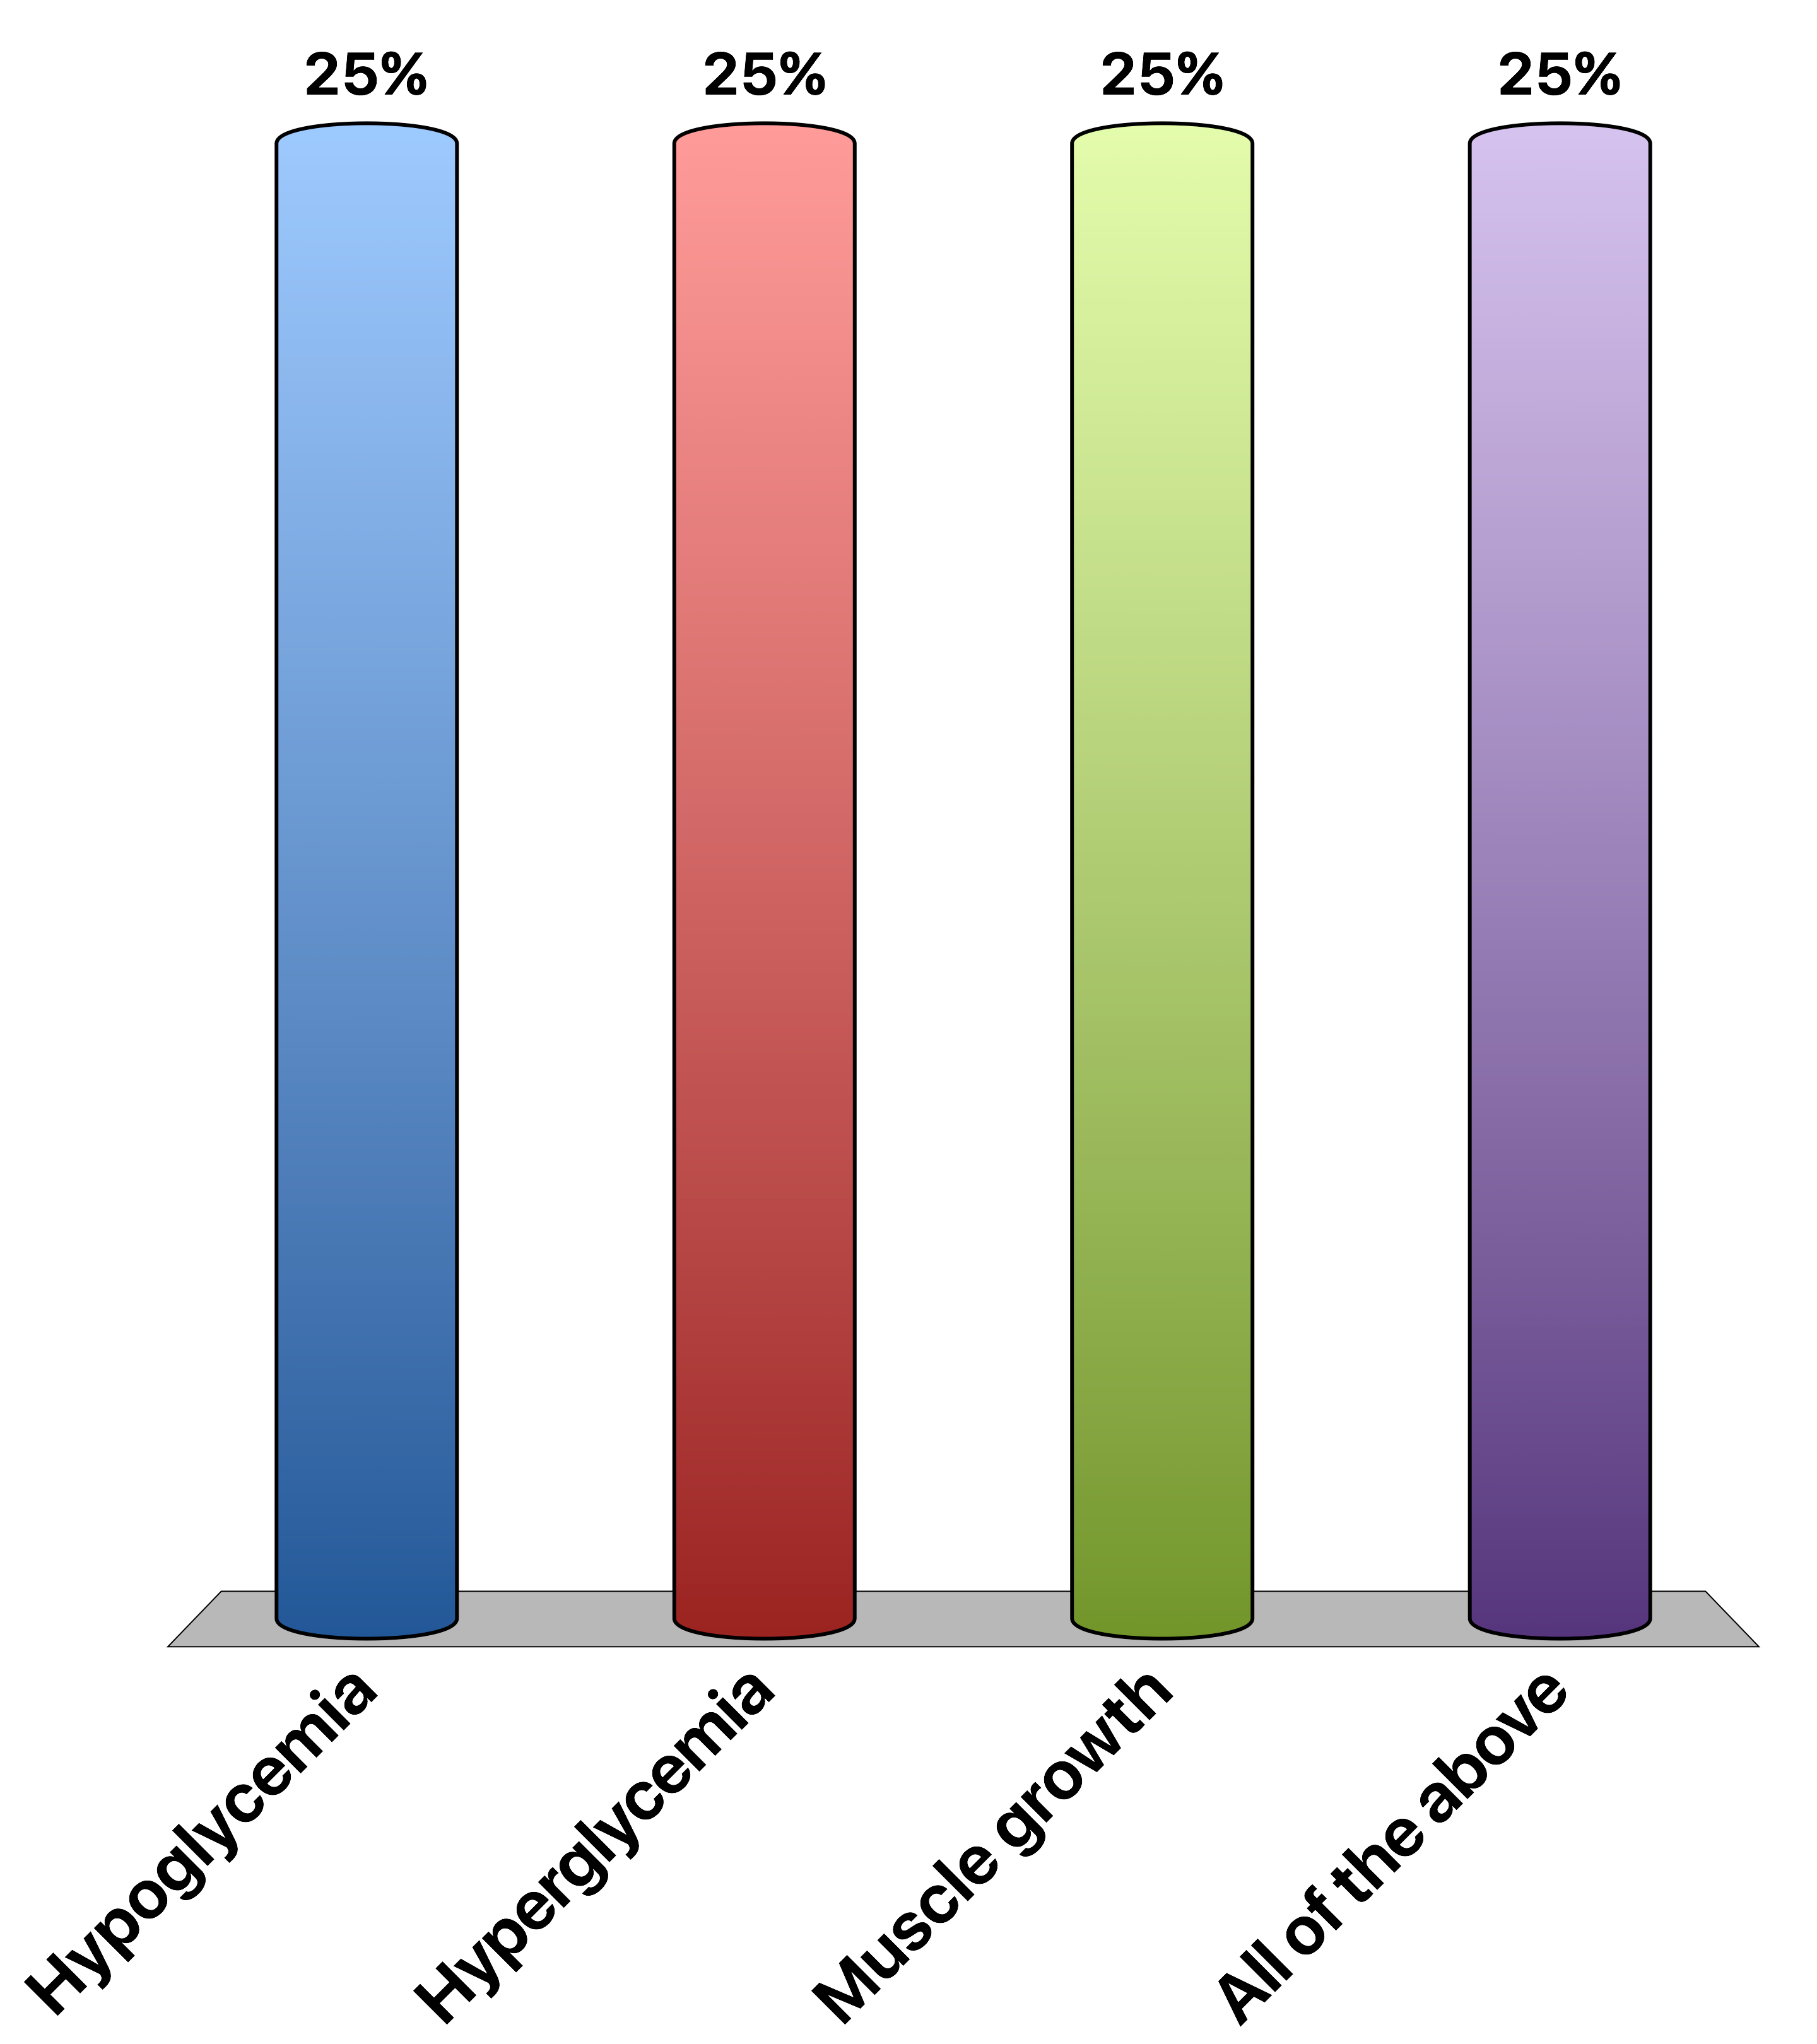
Chronically elevated glucocorticoid signaling would cause
Hypoglycemia
Hyperglycemia
Muscle growth
All of the above
Response Counter
15

Slide 2
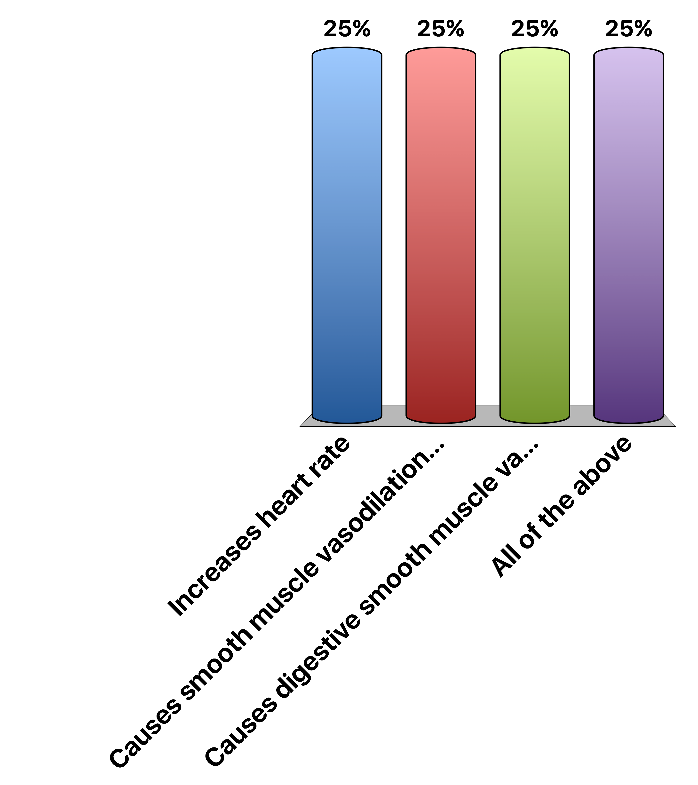
Epinephrine…
Increases heart rate
Causes smooth muscle vasodilation in skeletal muscle
Causes digestive smooth muscle vasoconstriction
All of the above
Response Counter
15

Slide 3
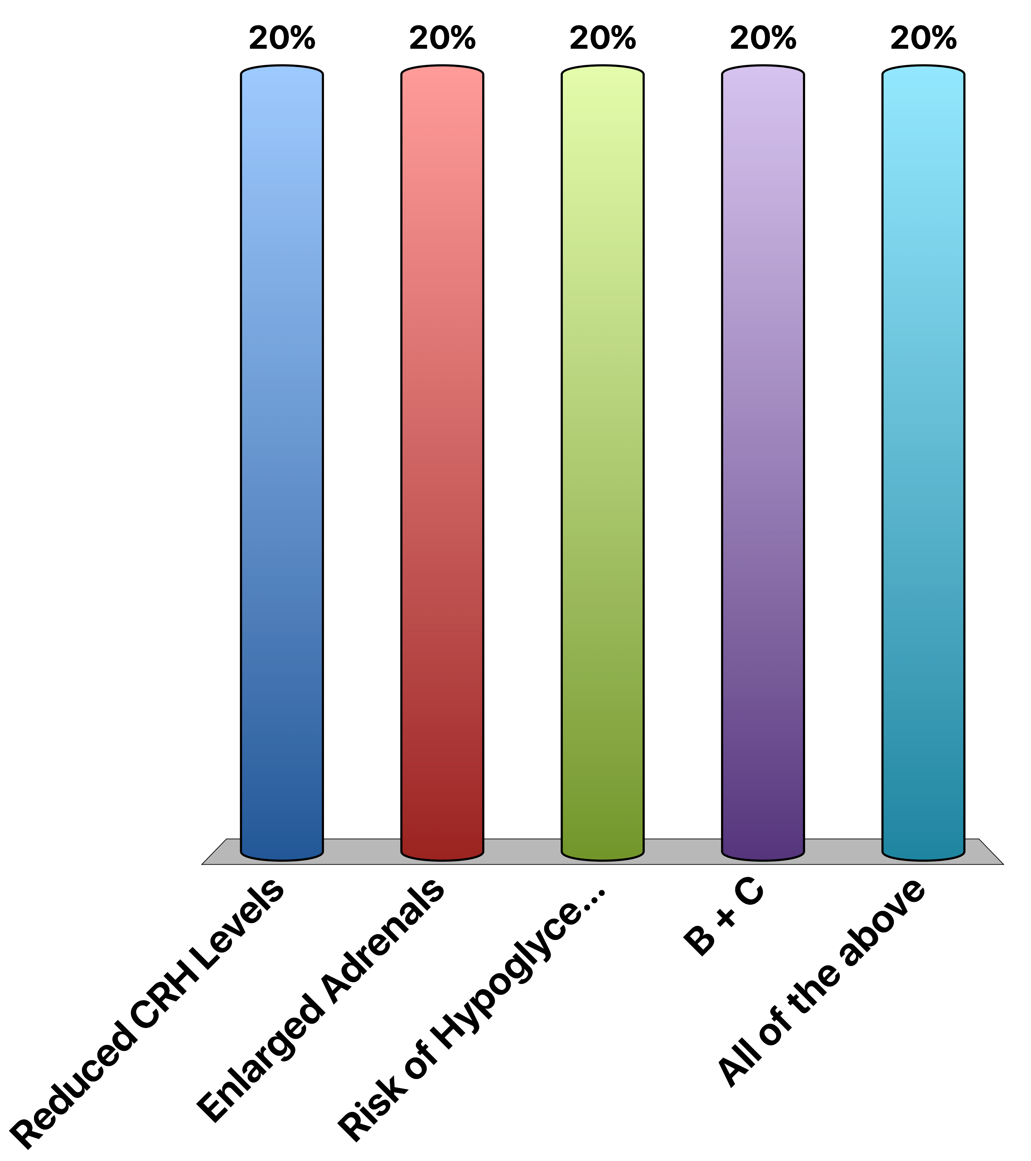
A Patient with a type of Congenital Adrenal Hyperplasia that can not make Cortisol Would be Expected to have…
Reduced CRH Levels
Enlarged Adrenals
Risk of Hypoglycemia
B + C
All of the above
Response Counter
15

Slide 4

CRH is released from the hypothalamus to the anterior pituitary, so therefore…
Response Counter
Is trafficked via the hypophysial portal system
Is Directly secreted via neurons which pass through the infundibulum
Binds a JAK/STAT receptor
All of the above
15

Slide 5
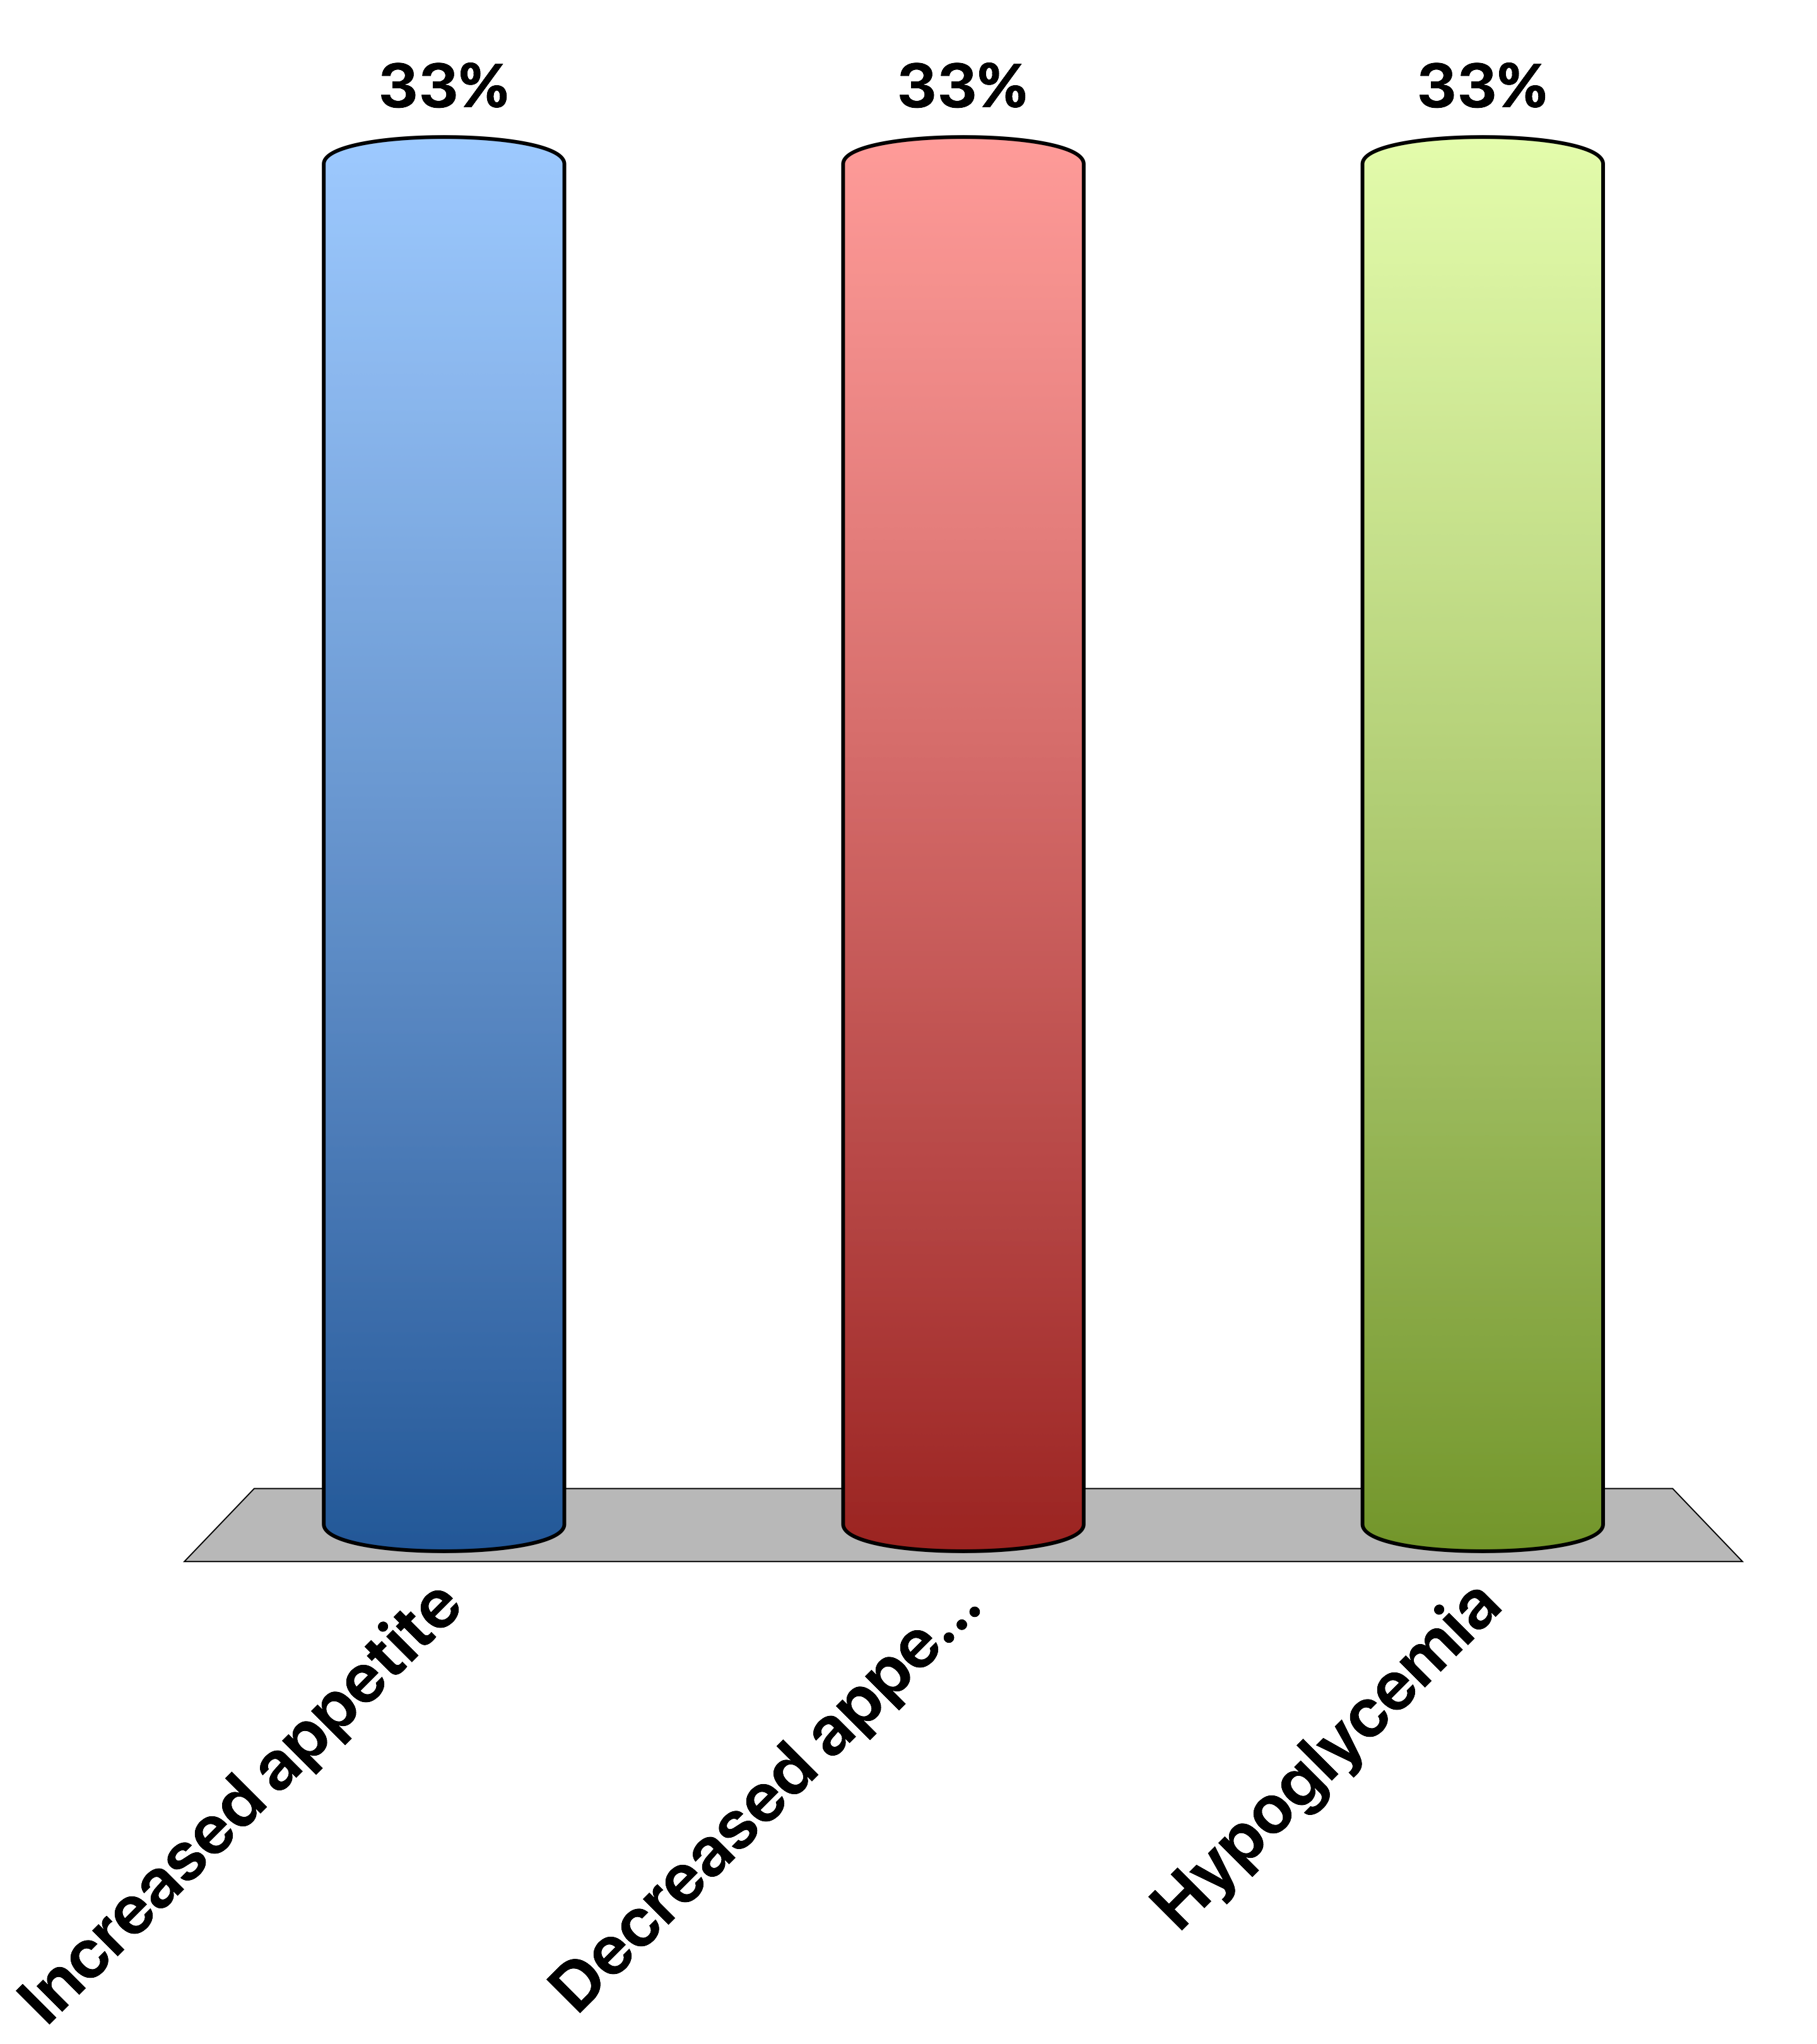
Brain insulin resistance would lead to
Increased appetite
Decreased appetite
Hypoglycemia
Response Counter
15

Slide 6
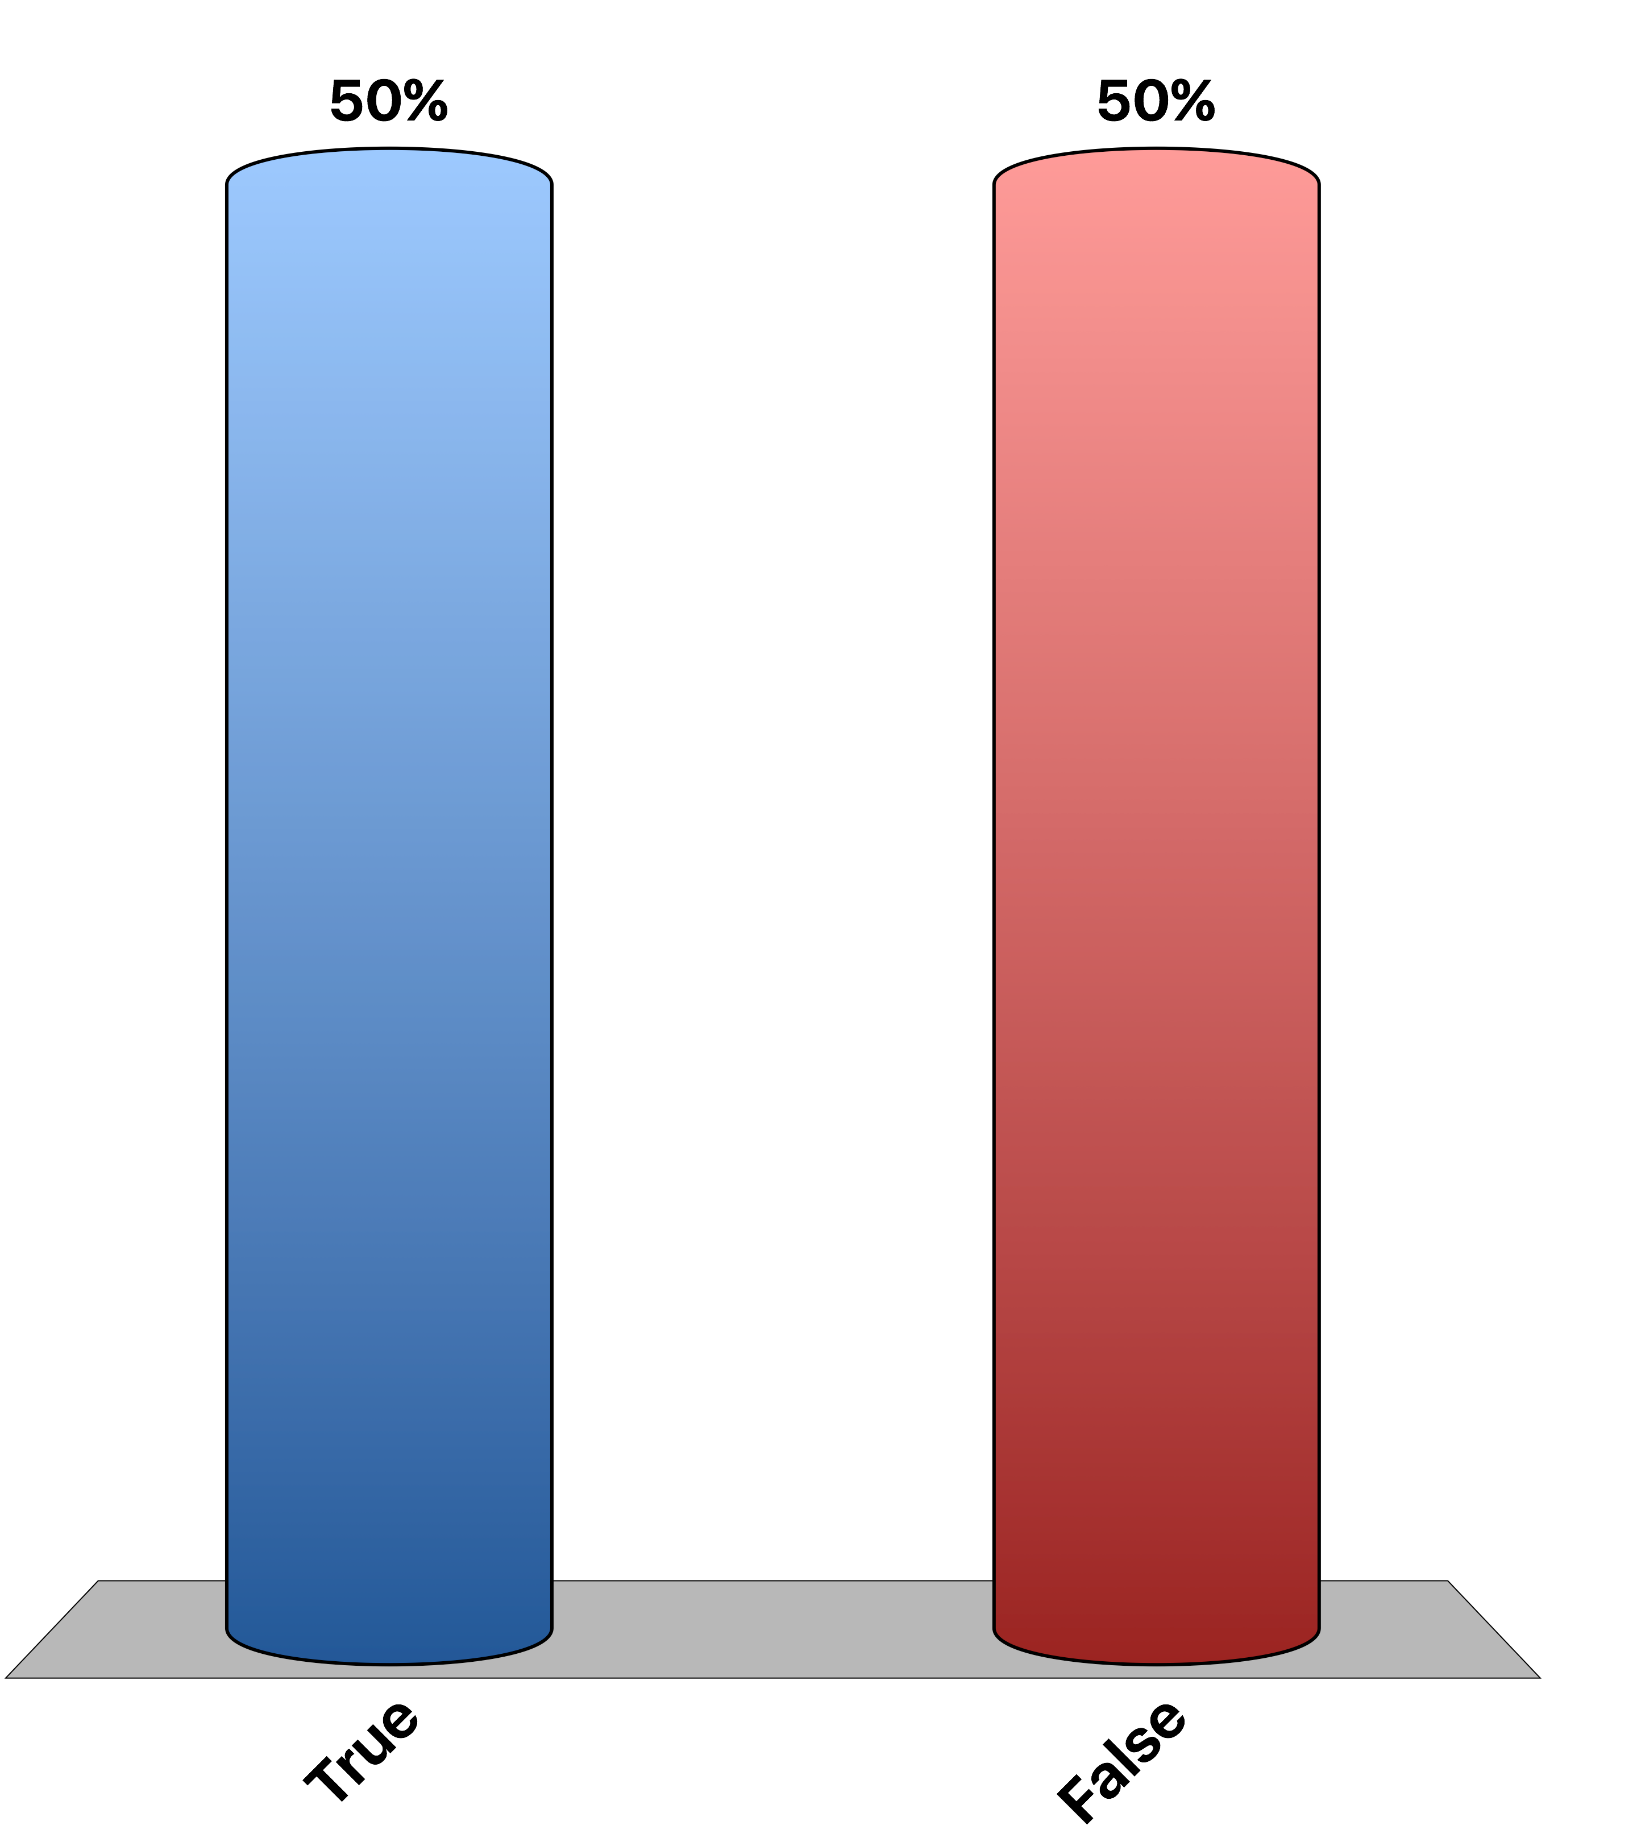
Glucose Uptake into Adipose/Muscle is Via Active Transport
True
False
Response Counter
15
Notes:
FALSE -> due to passive diffusion

Slide 7
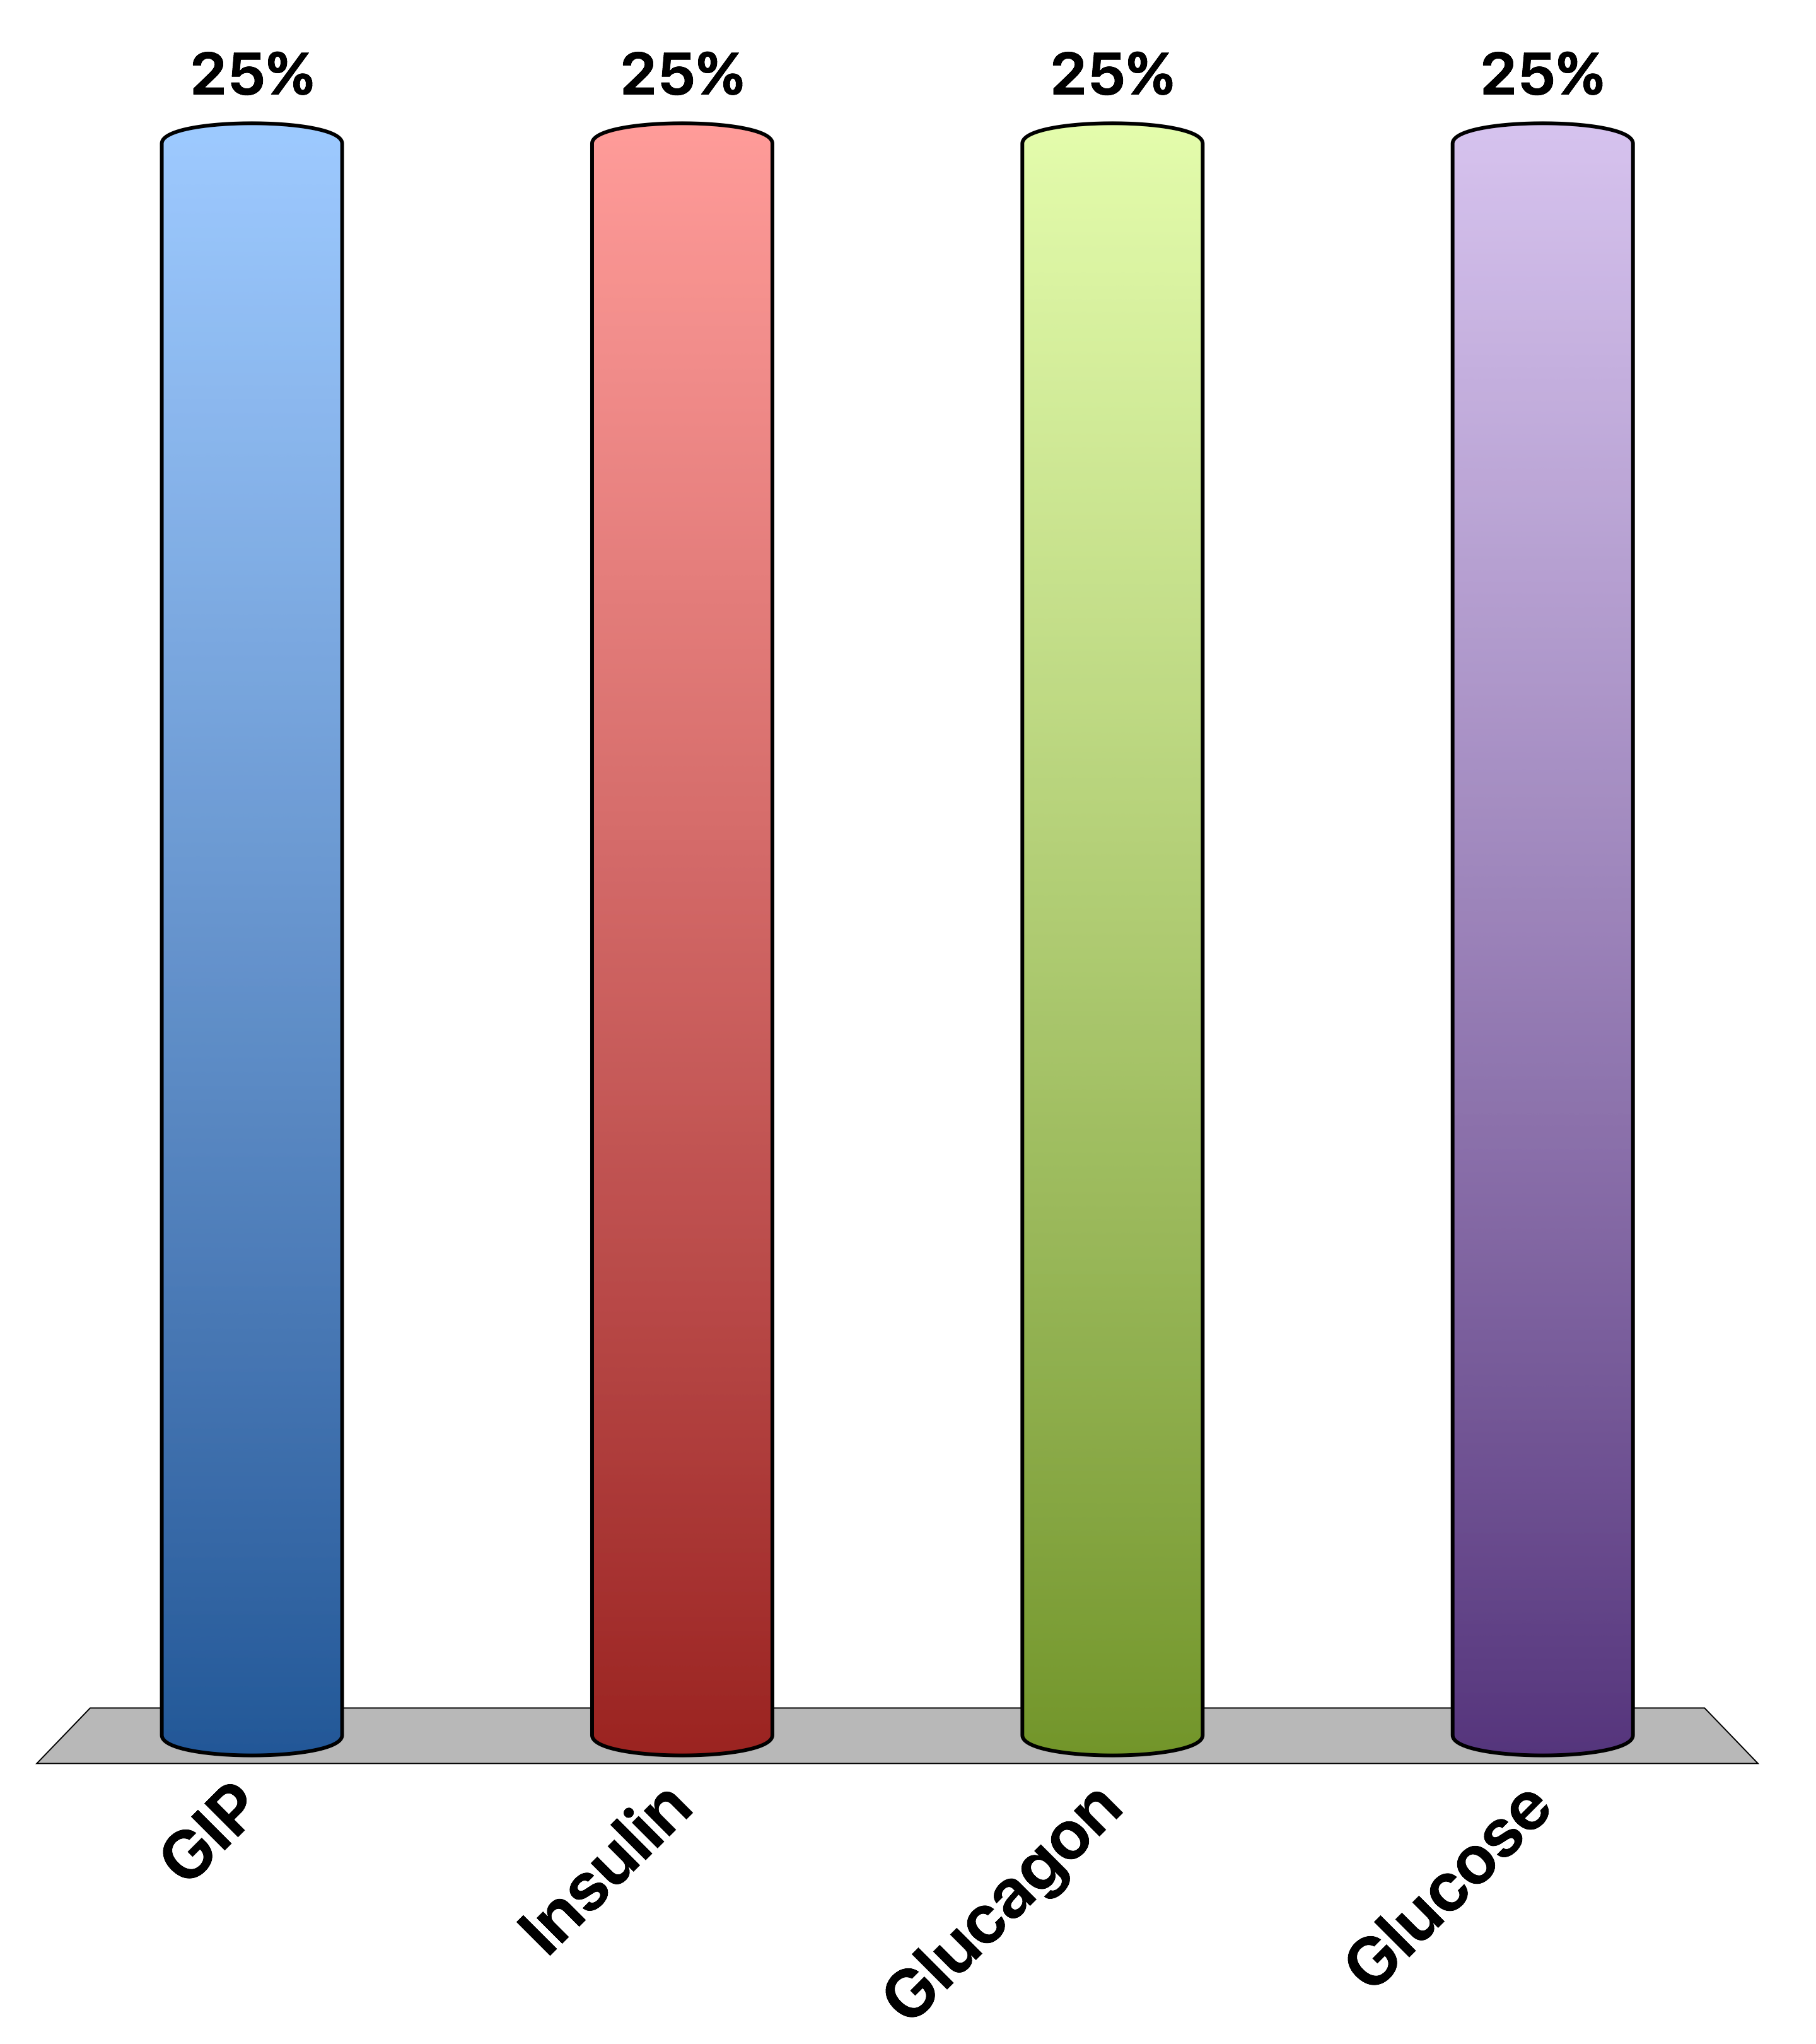
During Fasting Which Is Elevated
GIP
Insulin
Glucagon
Glucose
Response Counter
15
Notes:
C is correct

Slide 8
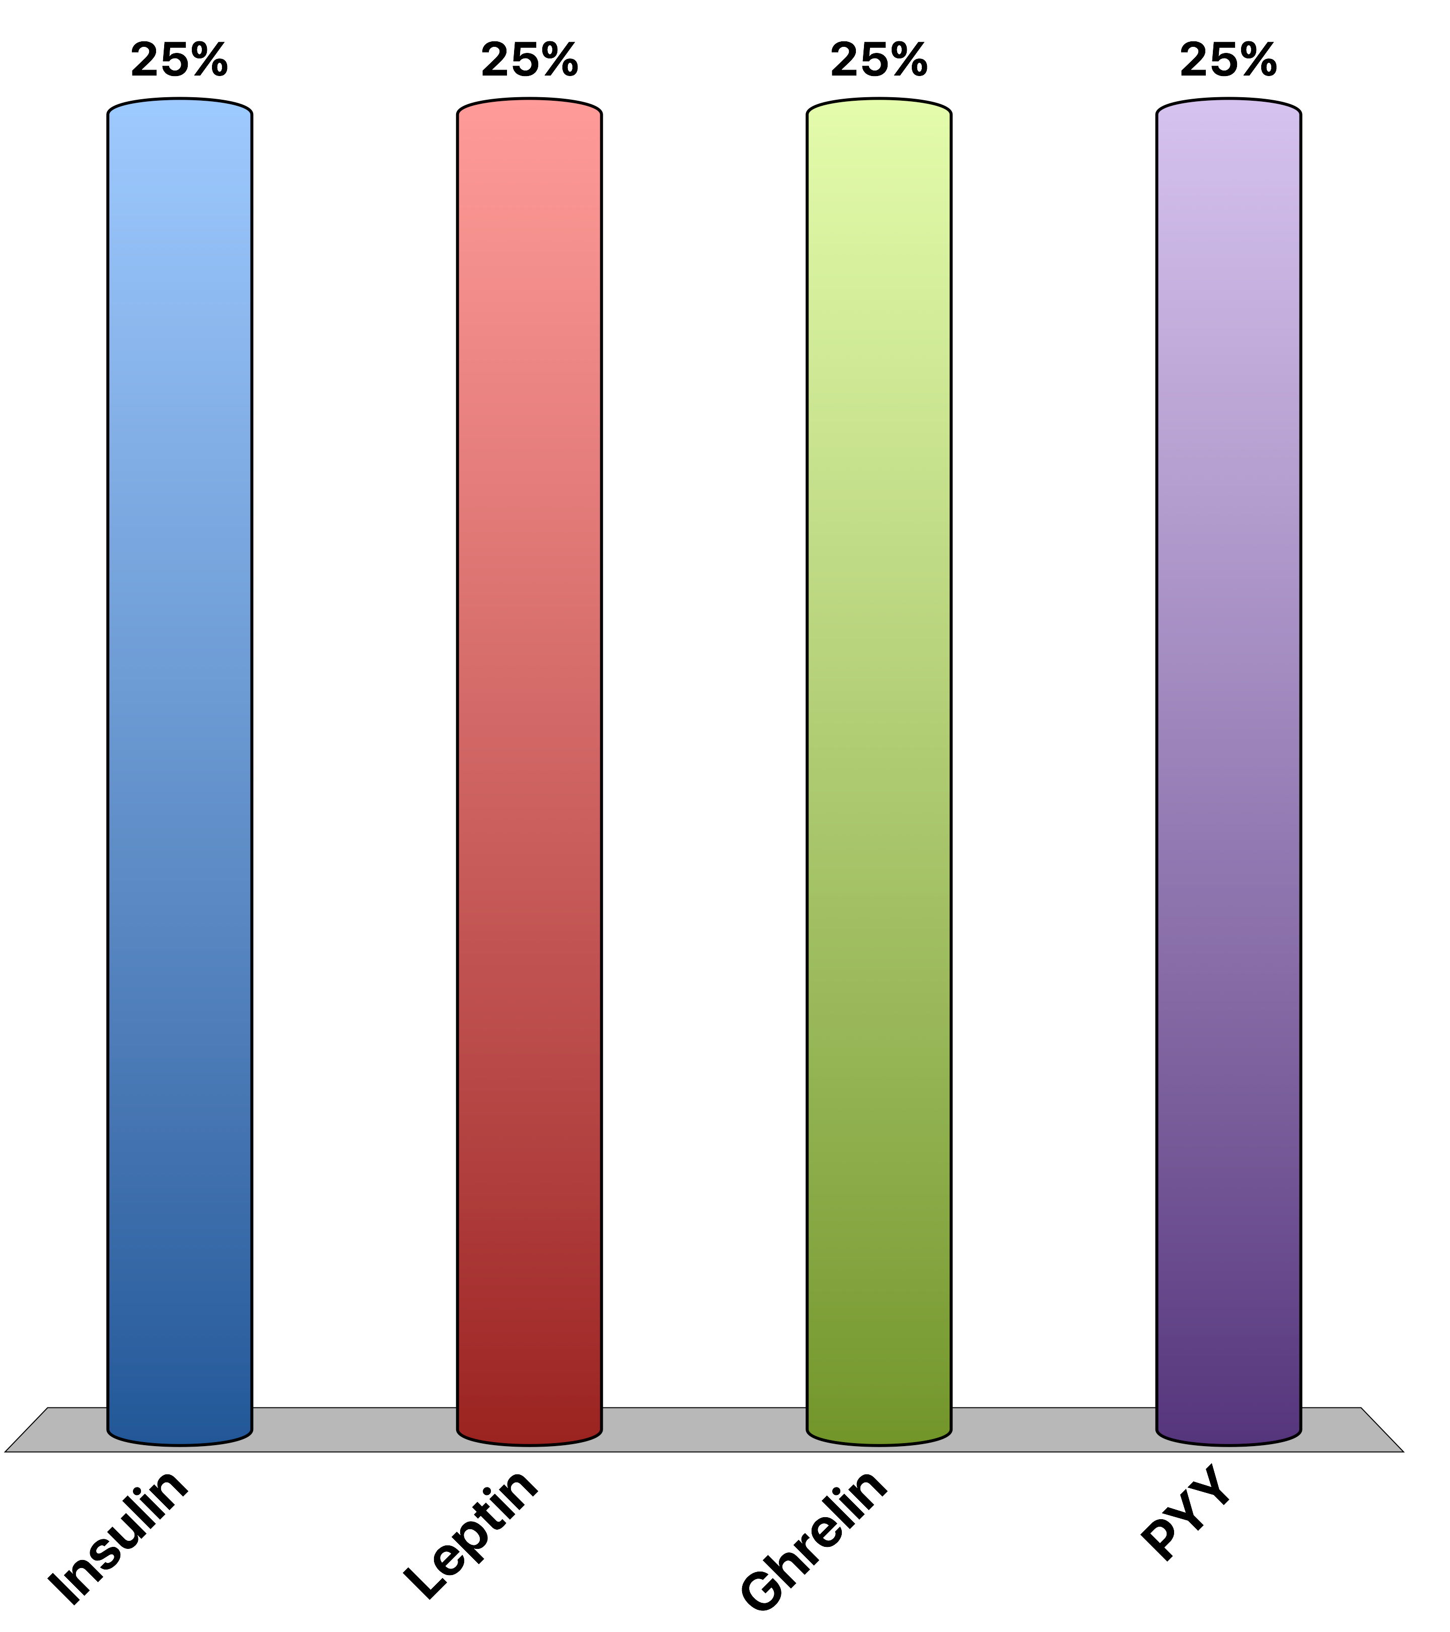
Which hormone stimulates appetite
Insulin
Leptin
Ghrelin
PYY
Response Counter
15

Slide 9

β-AR agonists would be good weight loss drugs except…
They would induce lipid breakdown
They would cause tachycardia
They would cause GI vasodilation
They would prevent gluconeogenesis in the liver
Response Counter
15

Slide 10
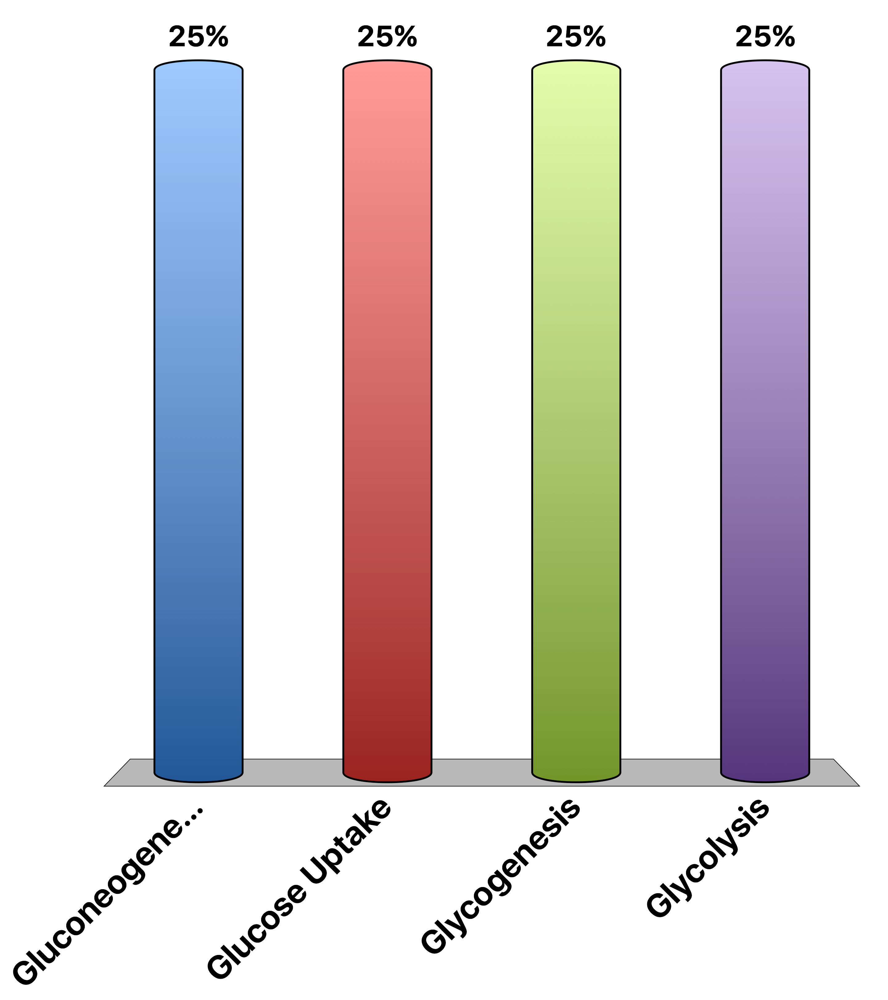
What does insulin NOT activate?
Gluconeogenesis
Glucose Uptake
Glycogenesis
Glycolysis
Response Counter
15

Slide 11
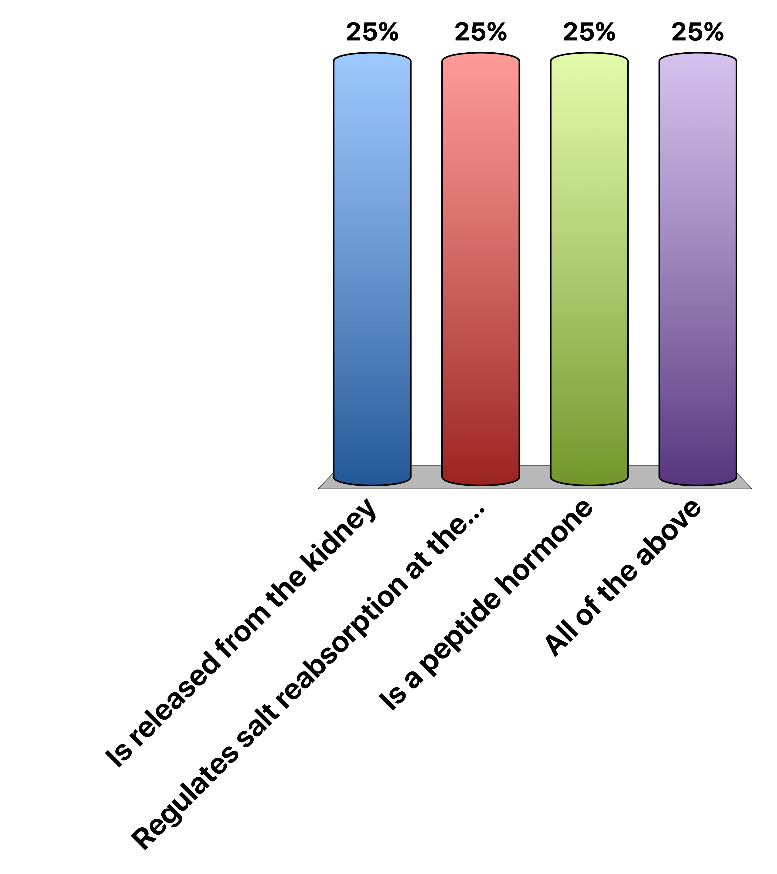
Aldosterone…
Is released from the kidney
Regulates salt reabsorption at the kidney
Is a peptide hormone
All of the above
Response Counter
15

Slide 12

Angiotensin…
Is from a precursor made primarily in the liver
Is processed by renin
Causes vasoconstriction
All of the above
Response Counter
15

Slide 13

A mouse with no Leptin Receptor
Would overeat because it cant respond to leptin
Would not eat because it cant respond to leptin
Would over-eat because it responds too strongly to leptin
Would not eat because it responds too strongly to leptin
Response Counter
15

Slide 14
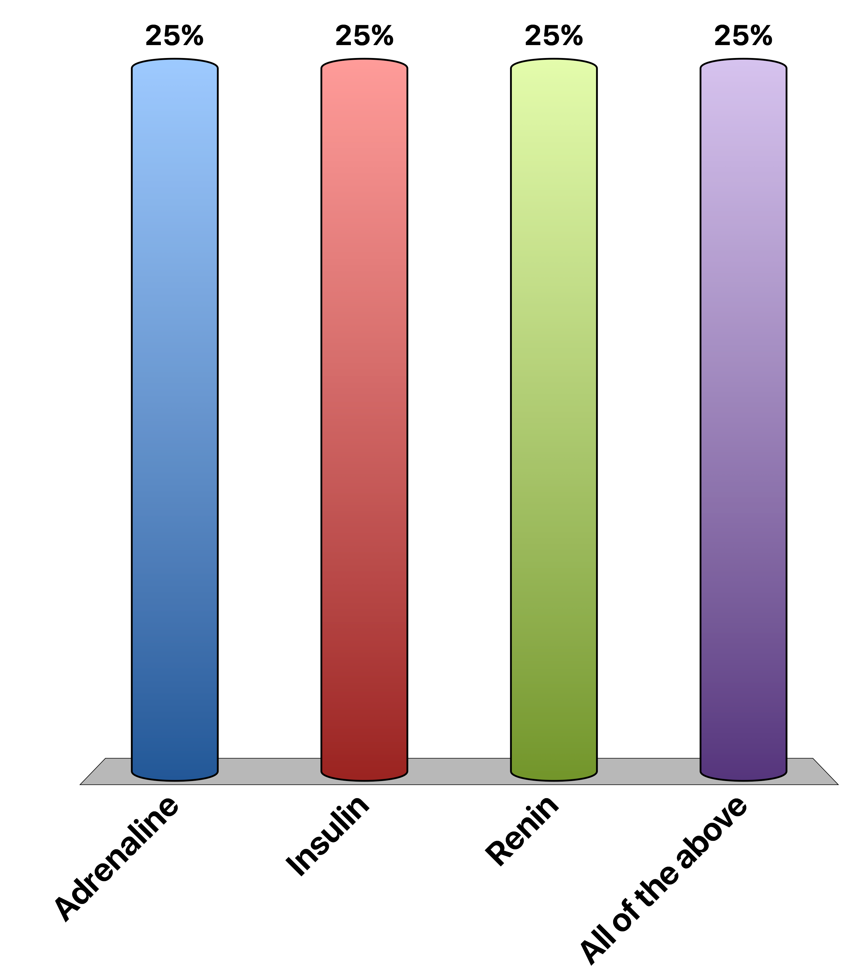
When the fight or flight response increases blood flow to muscles, what is the signal
Adrenaline
Insulin
Renin
All of the above
Response Counter
15

Slide 15
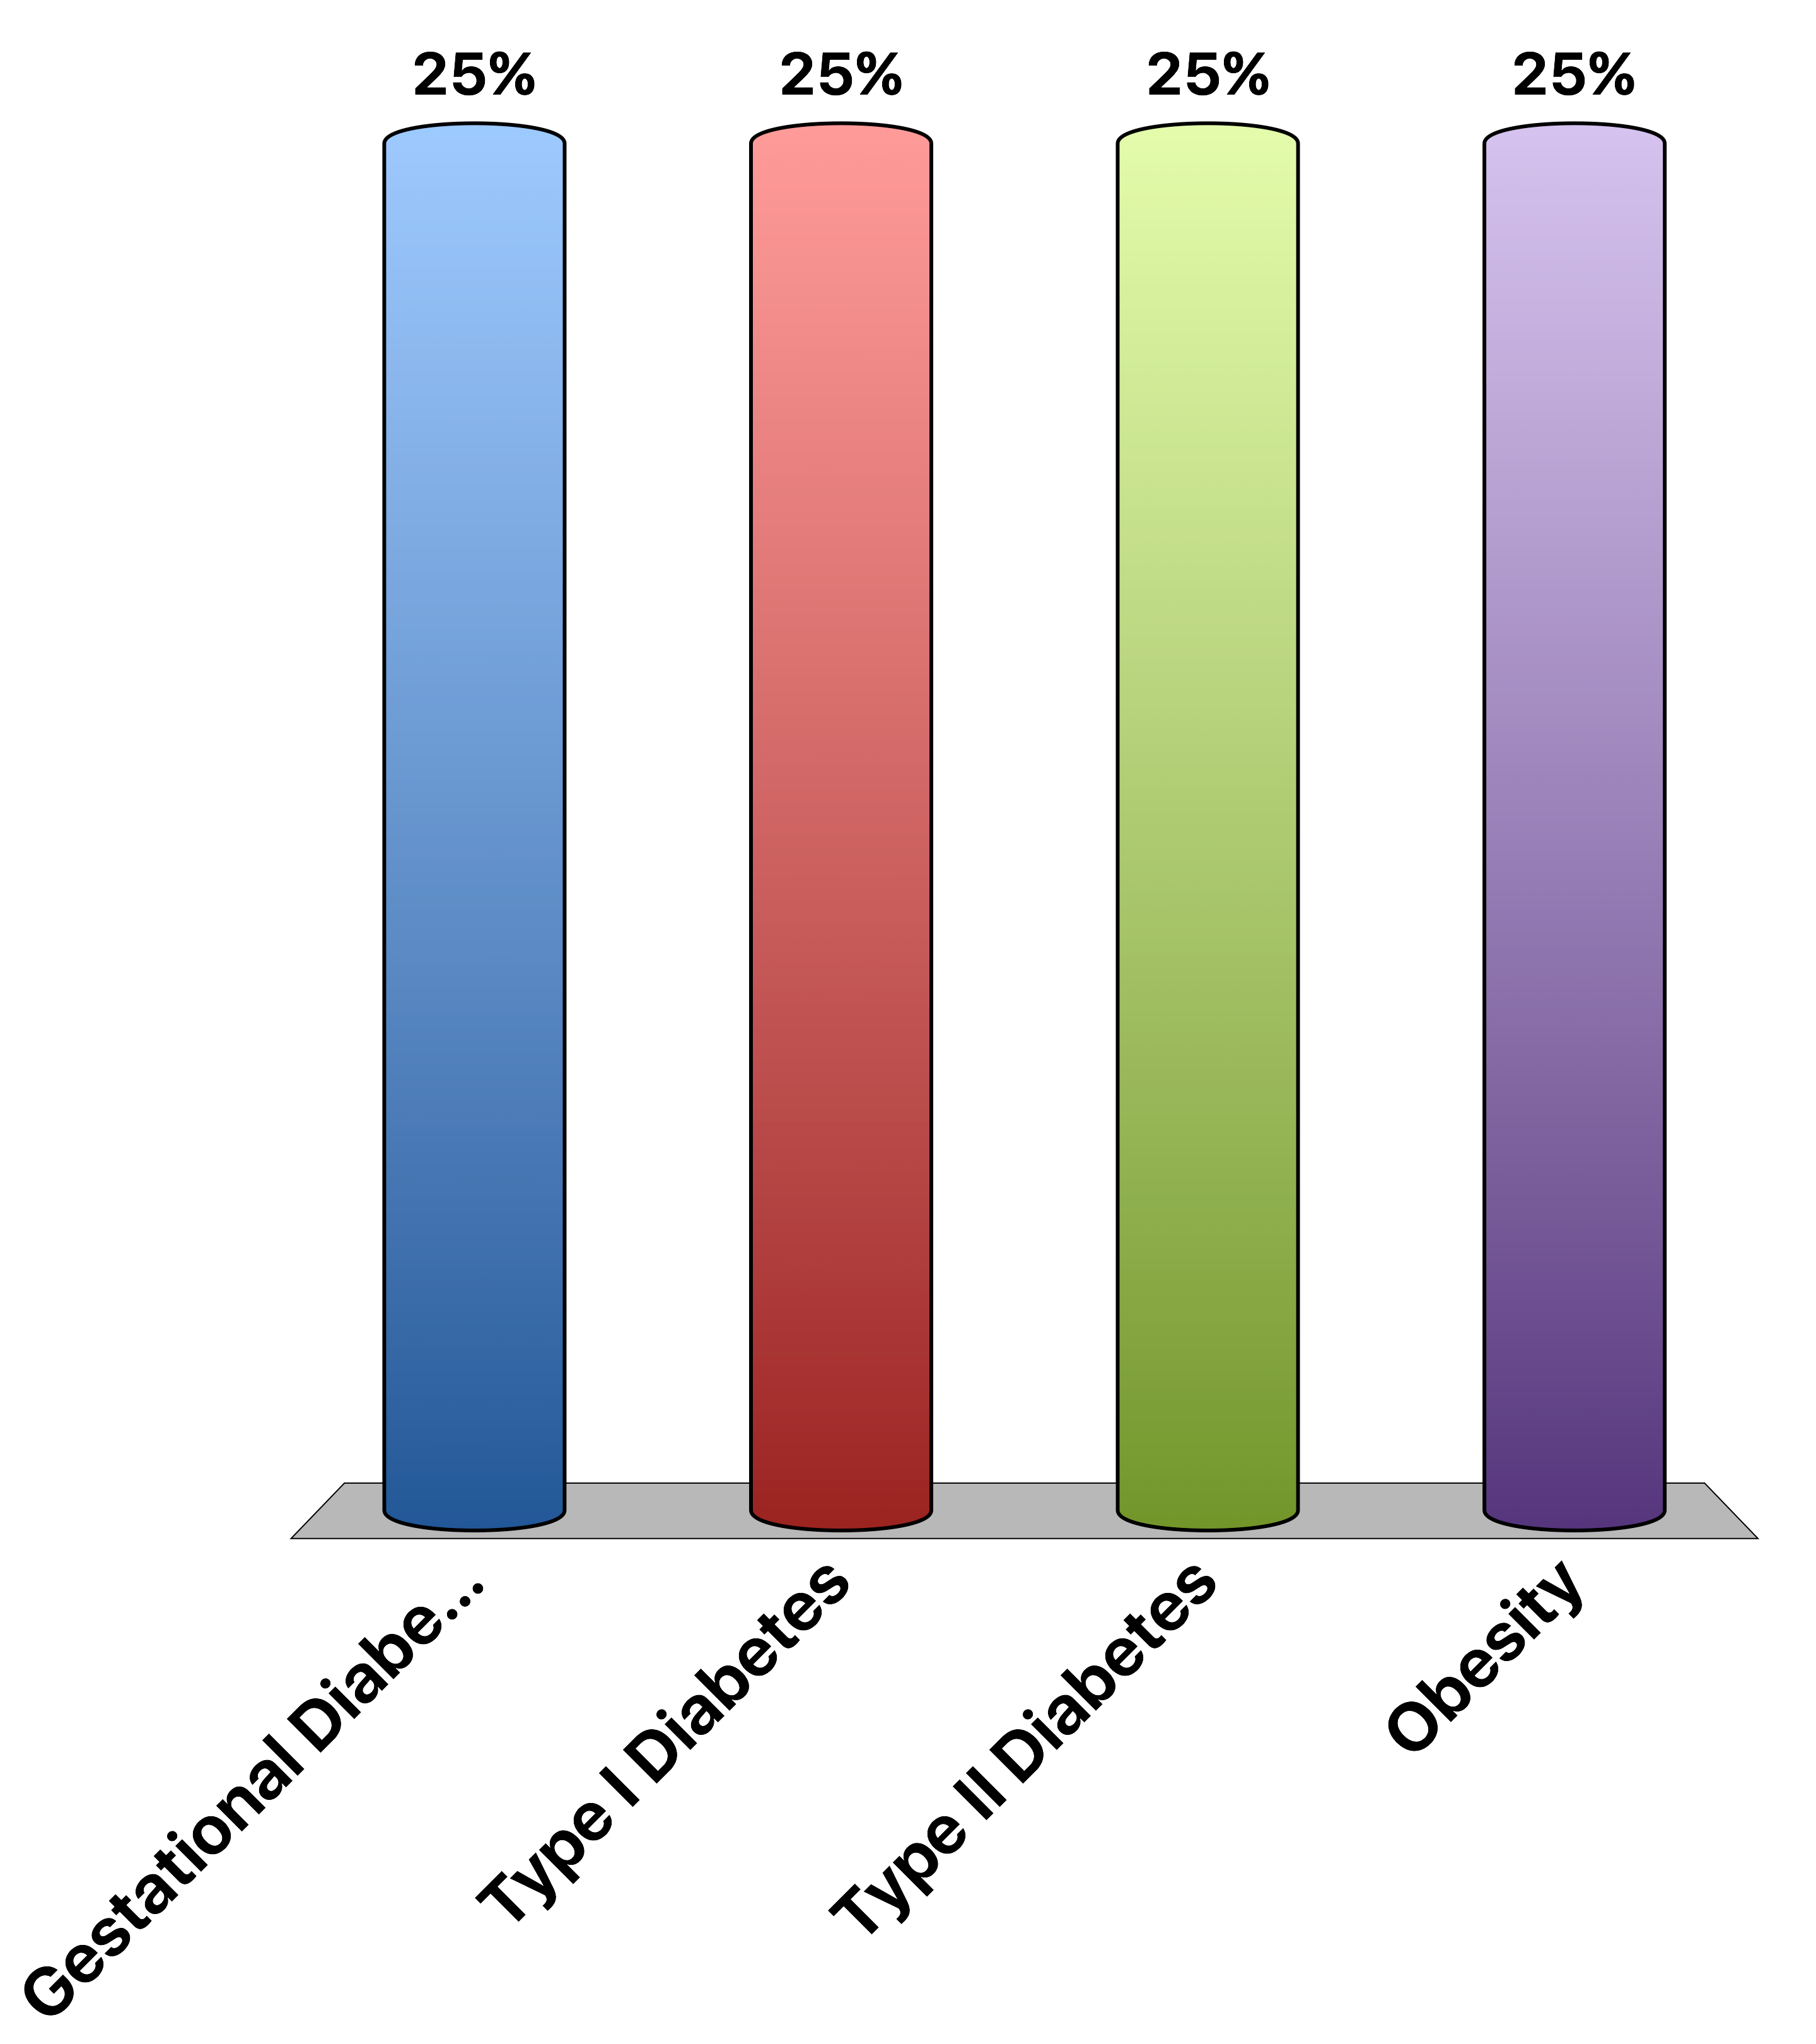
A lack of insulin production causes
Gestational Diabetes
Type I Diabetes
Type II Diabetes
Obesity
Response Counter
15
Notes:
Correct answer is B

Slide 16
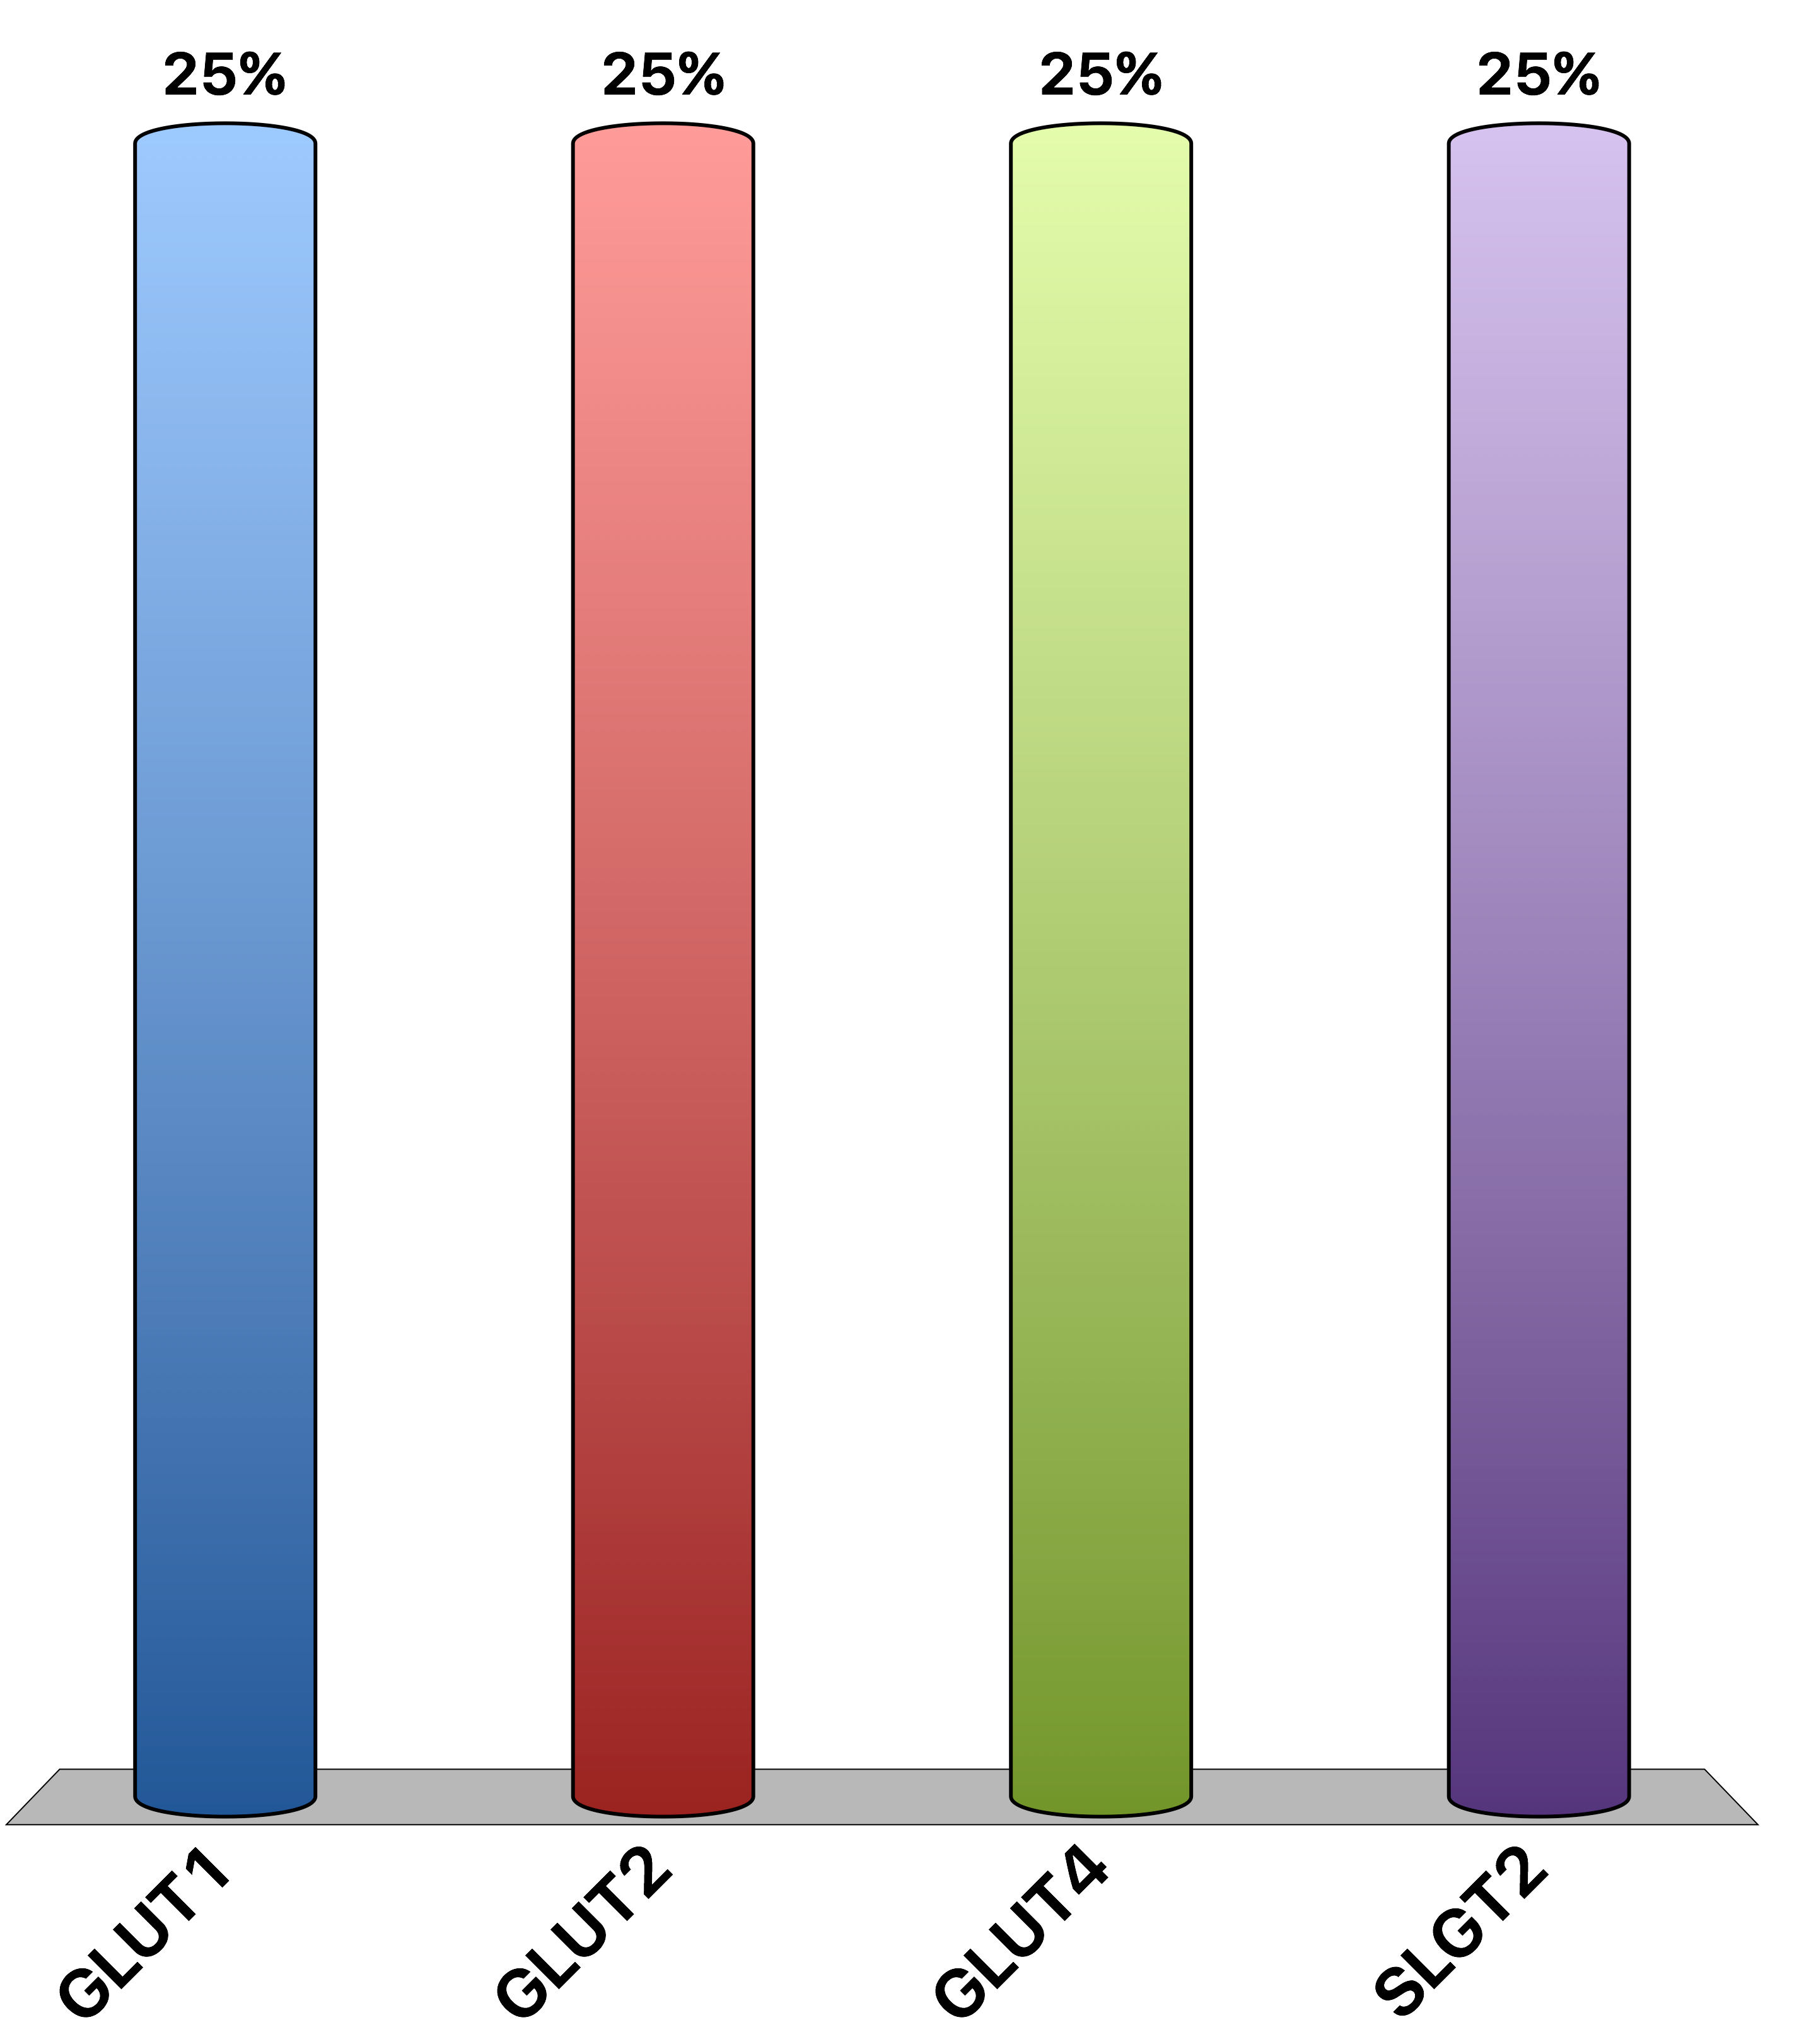
What is the main insulin responsive glucose transporter
GLUT1
GLUT2
GLUT4
SLGT2
Response Counter
15

Slide 17
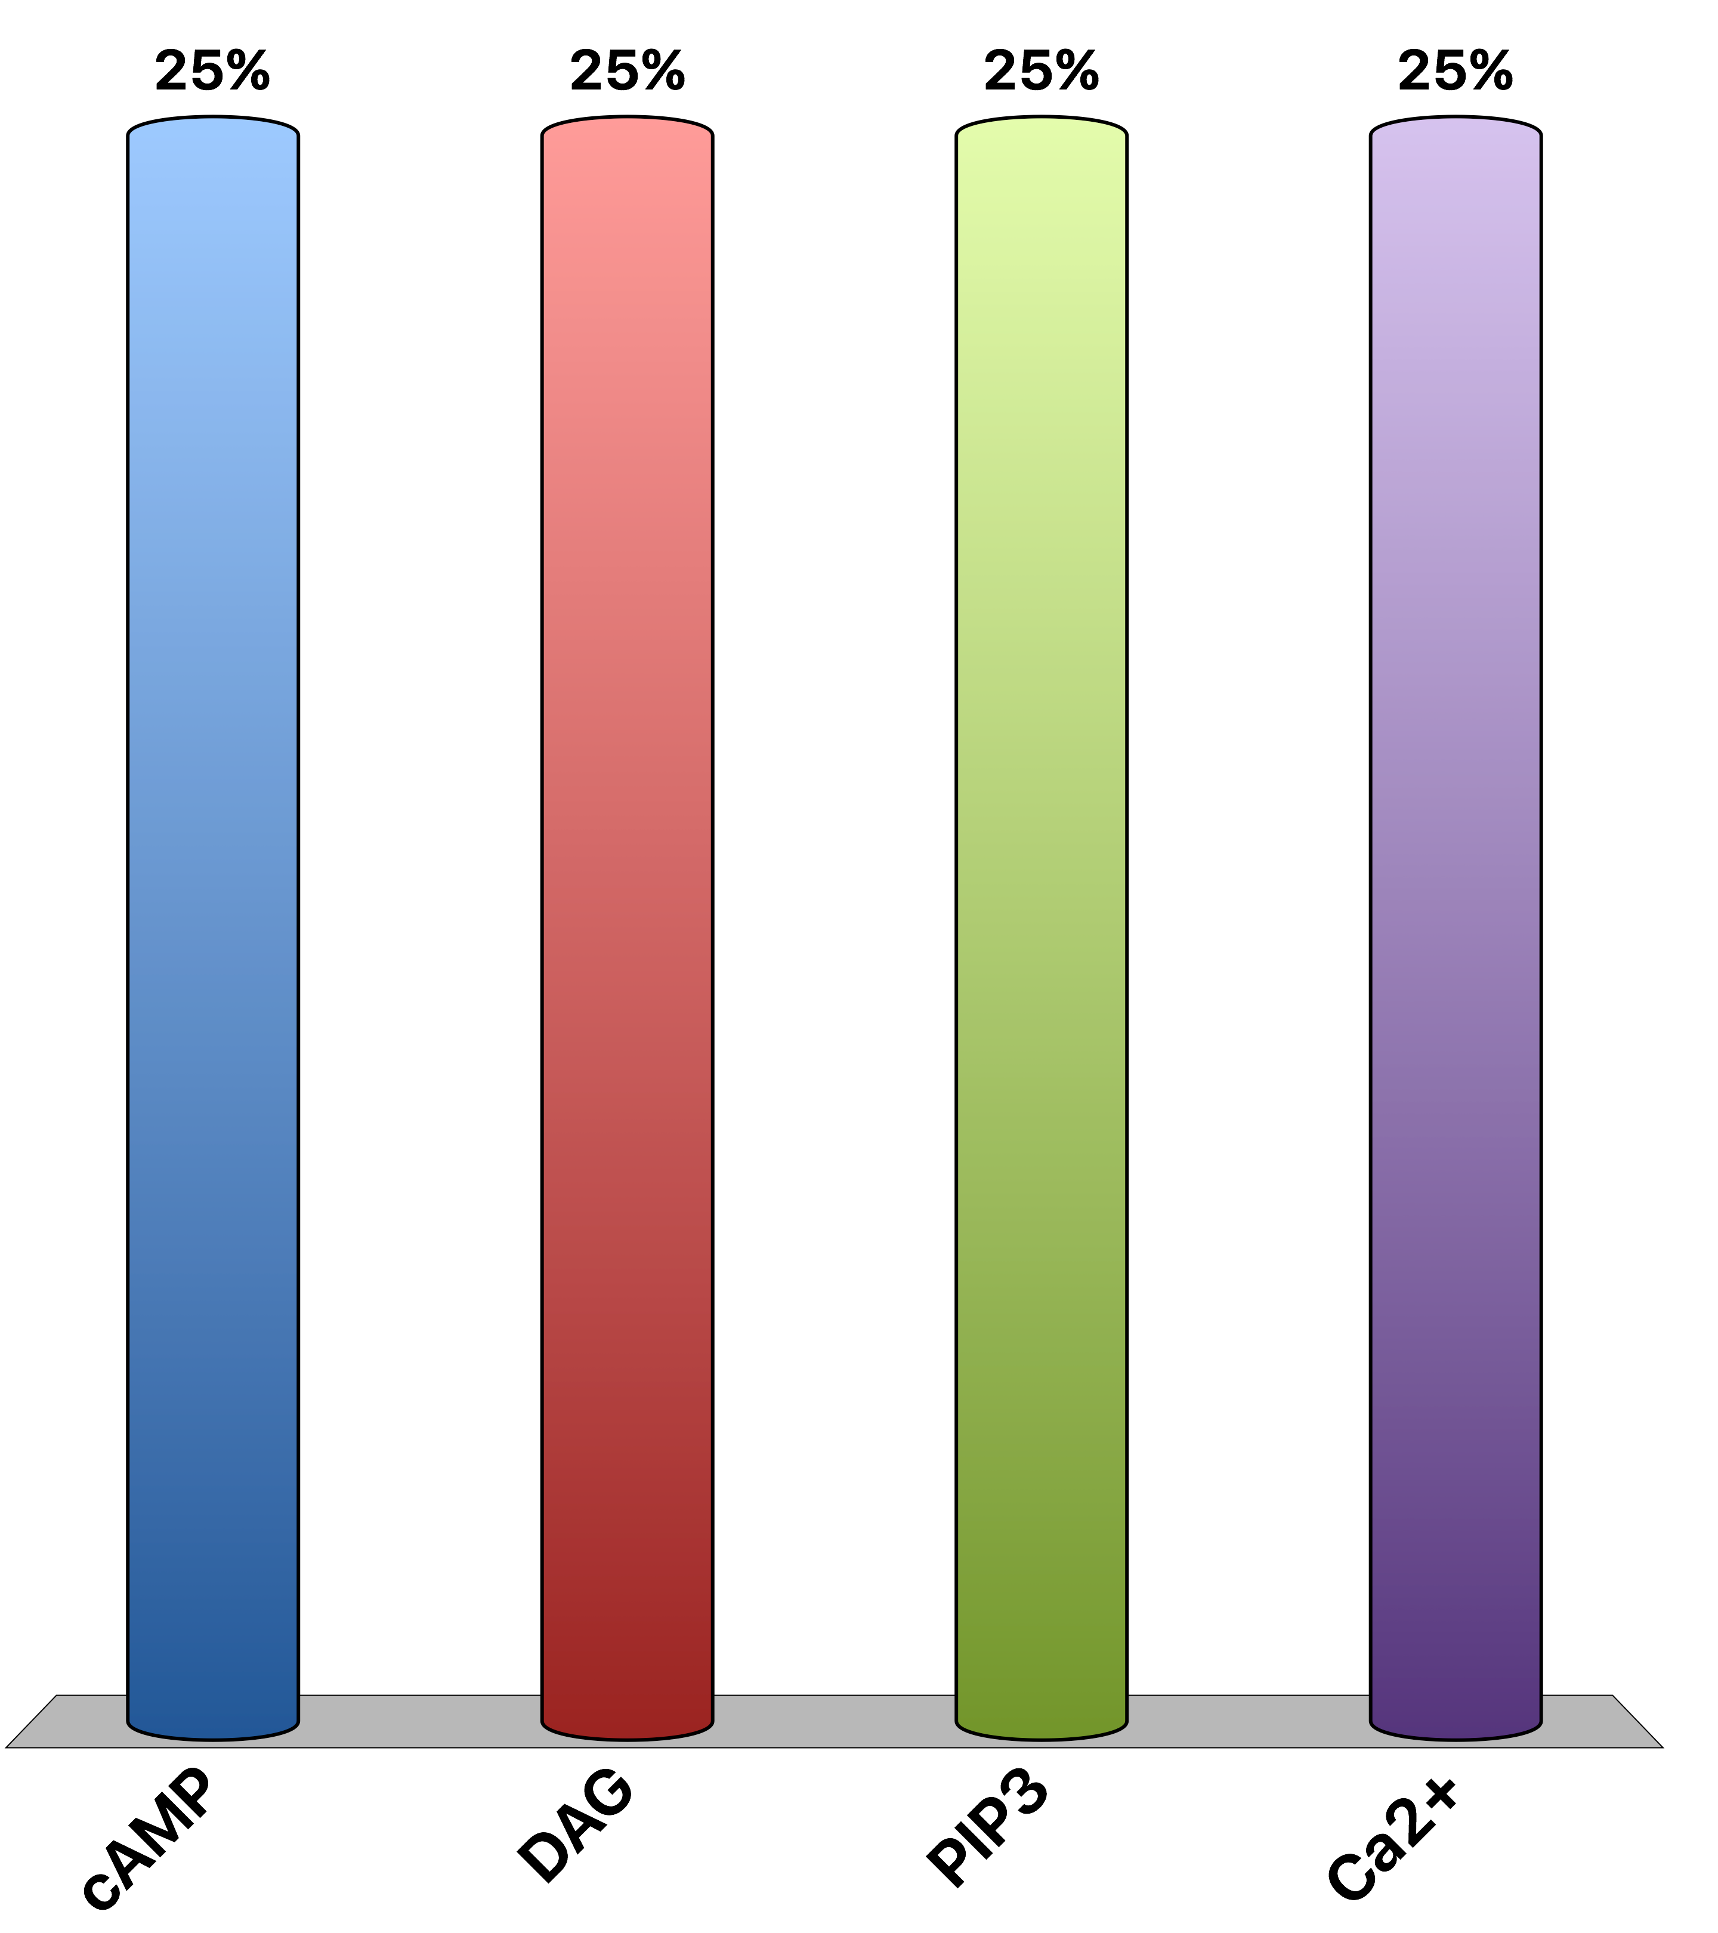
Which is the main second messenger in glucagon signaling
cAMP
DAG
PIP₃
Ca²⁺
Response Counter
15

Slide 18
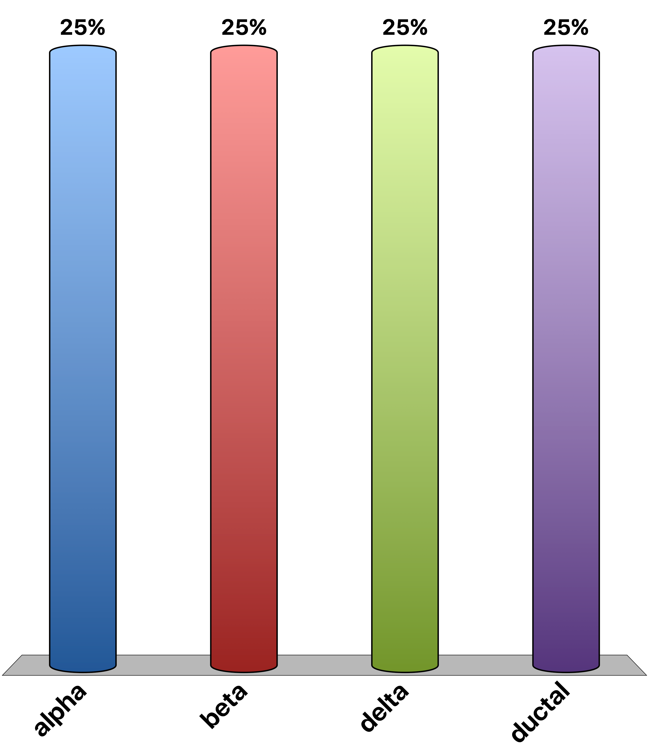
Which are exocrine cells?
alpha
beta
delta
ductal
Response Counter
15

Slide 19
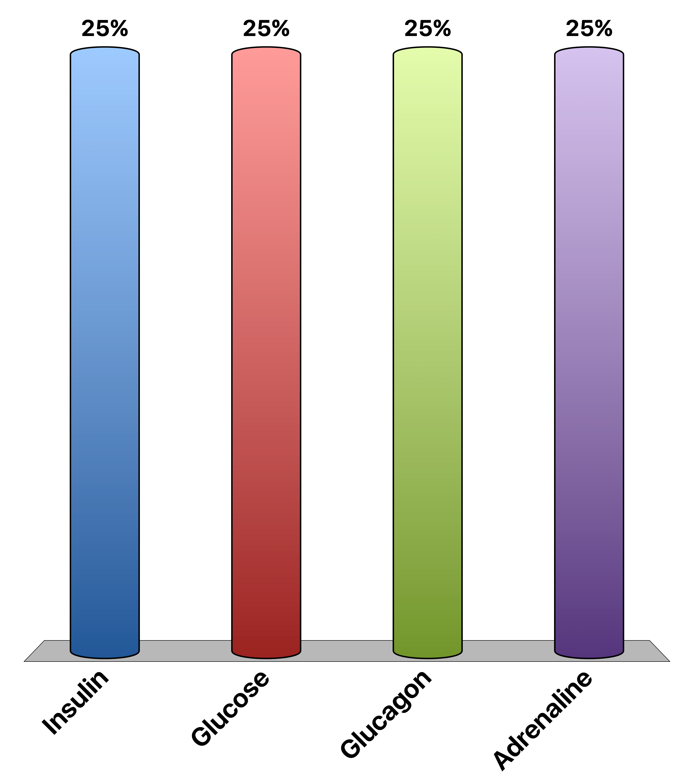
A patient is rushed to the hospital with low blood glucose, what would be a bad treatment?
Insulin
Glucose
Glucagon
Adrenaline
Response Counter
15

Slide 20
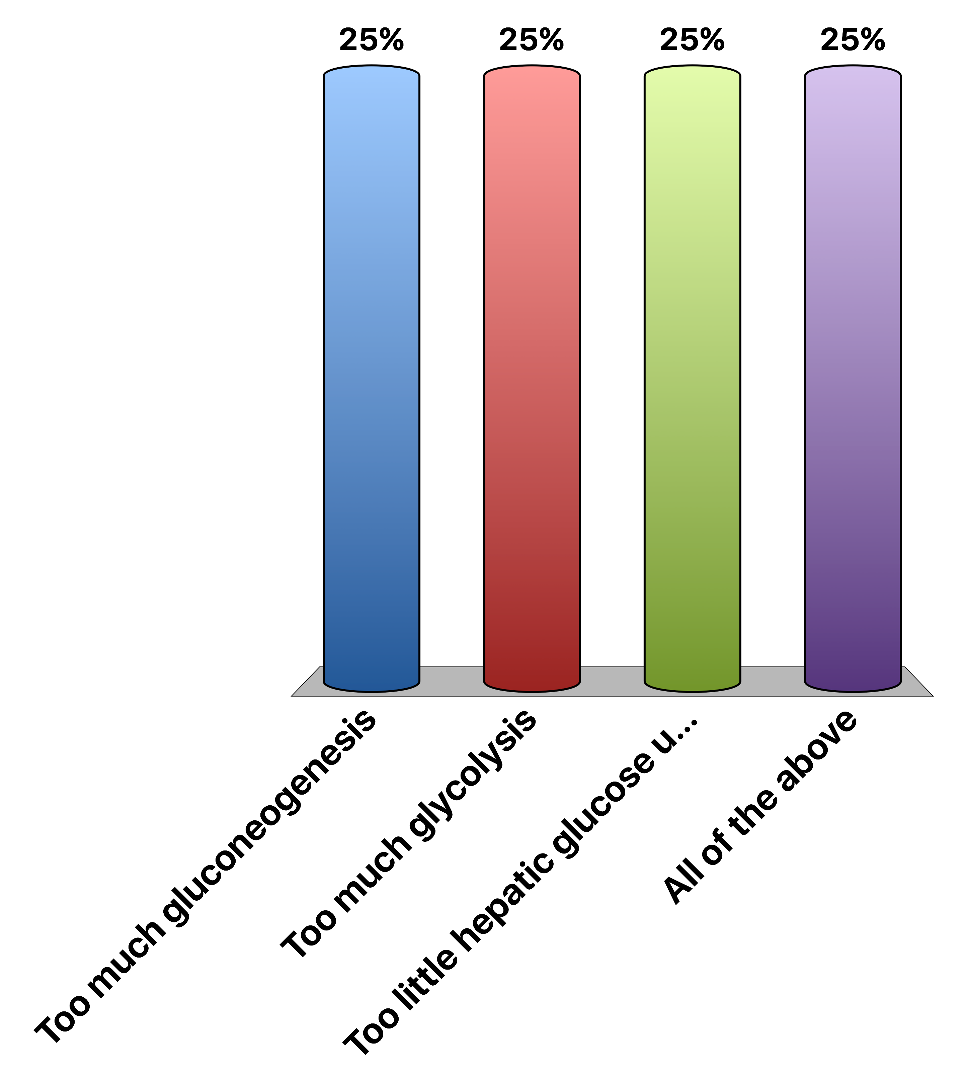
Why would liver insulin resistance cause hyperglycemia
Too much gluconeogenesis
Too much glycolysis
Too little hepatic glucose uptake
All of the above
Response Counter
15

Slide 21
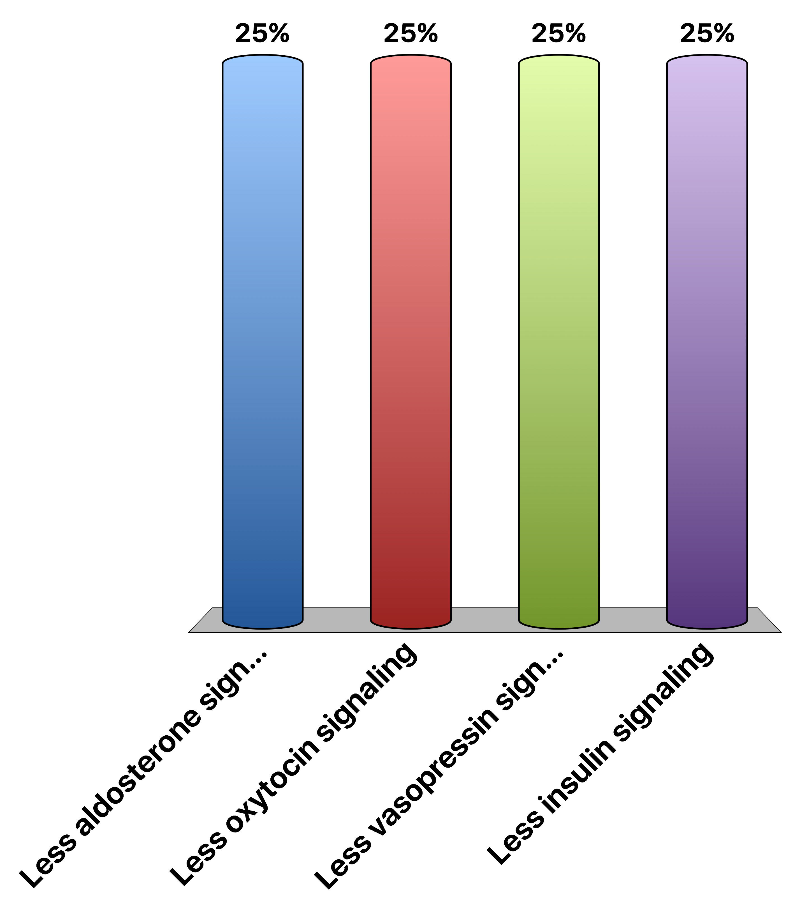
What causes diabetes insipidus
Less aldosterone signaling
Less oxytocin signaling
Less vasopressin signaling
Less insulin signaling
Response Counter
15

Slide 22
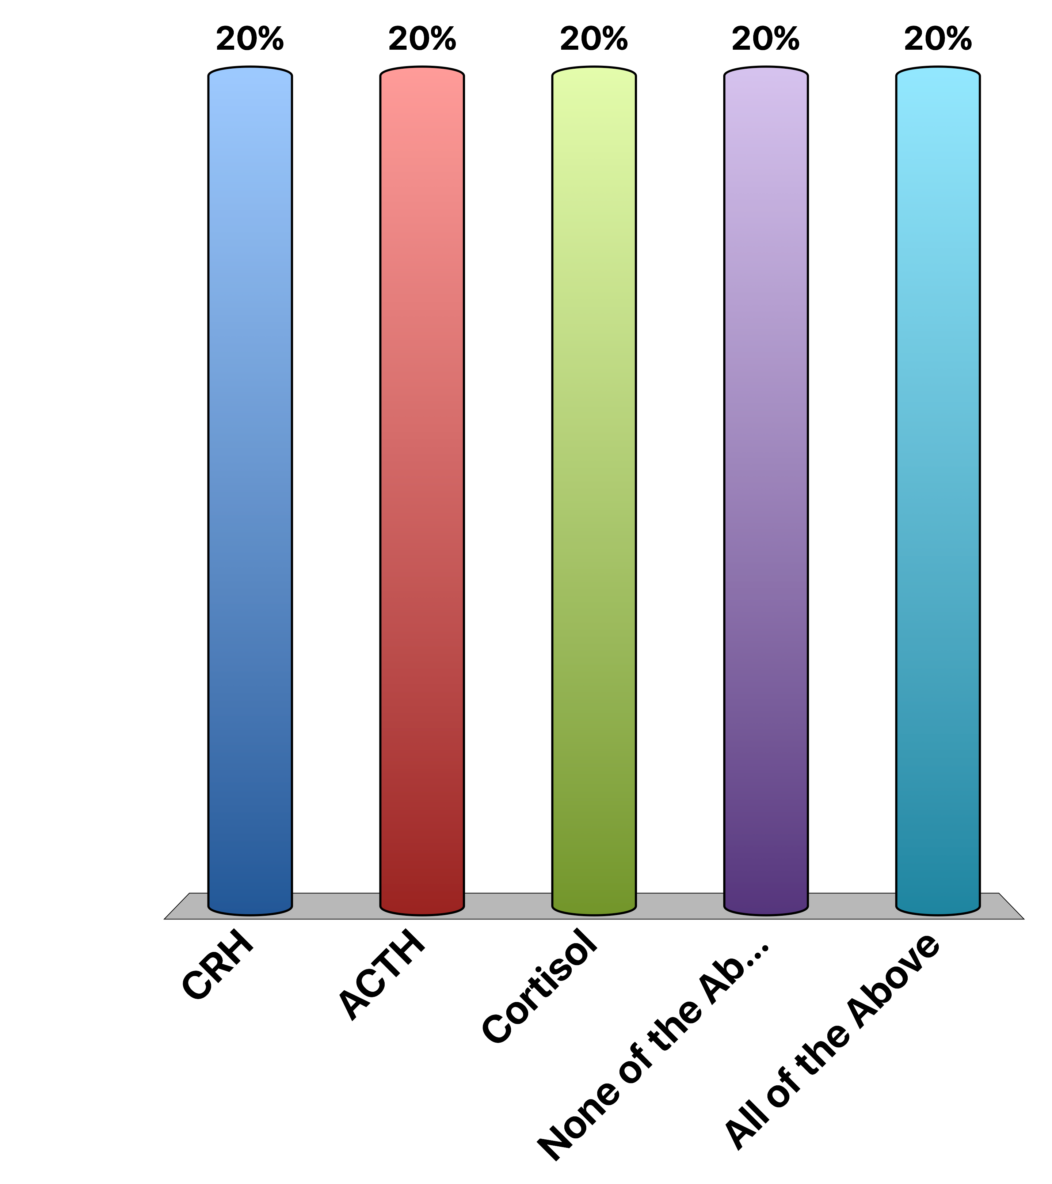
Which of these are directly released in a neuroendocrine manner?
CRH
ACTH
Cortisol
None of the Above
All of the Above
Response Counter
15

Slide 23
Can you recapitulate all the effects of GH by Providing IGF-1?
True
False
Response Counter
15
Notes:
Dual-effector hypothesis

Slide 24
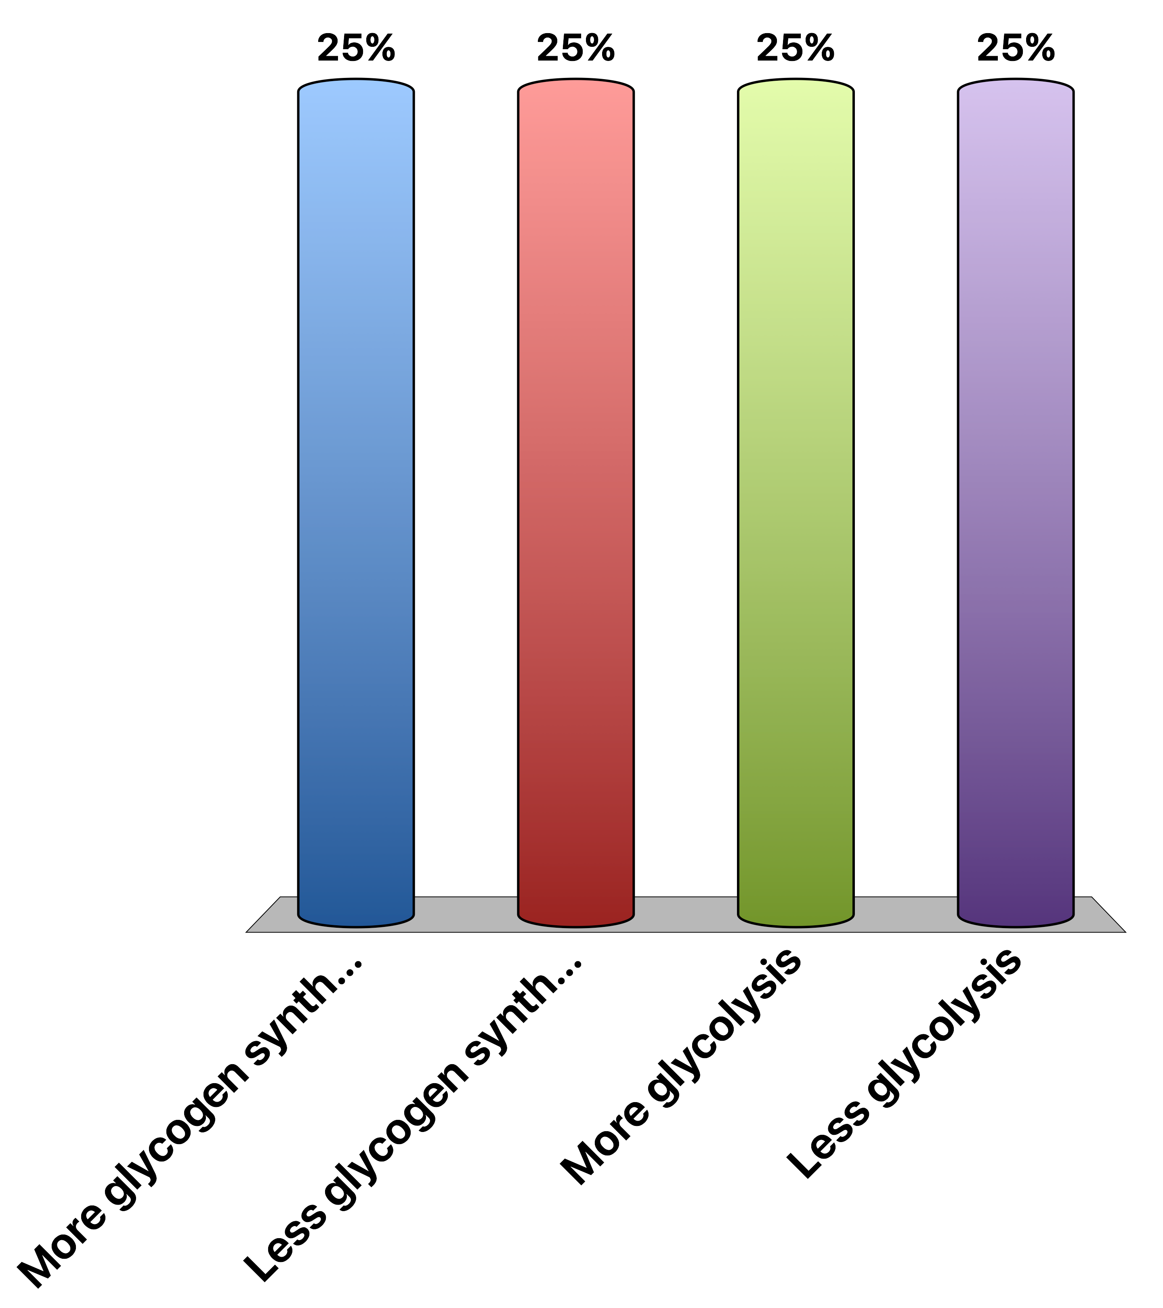
What is the effect of dephosphorylating glycogen synthase and glycogen phosphorylase?
More glycogen synthesis
Less glycogen synthesis
More glycolysis
Less glycolysis
Response Counter
15
Notes:
Correct answer is A

Slide 25
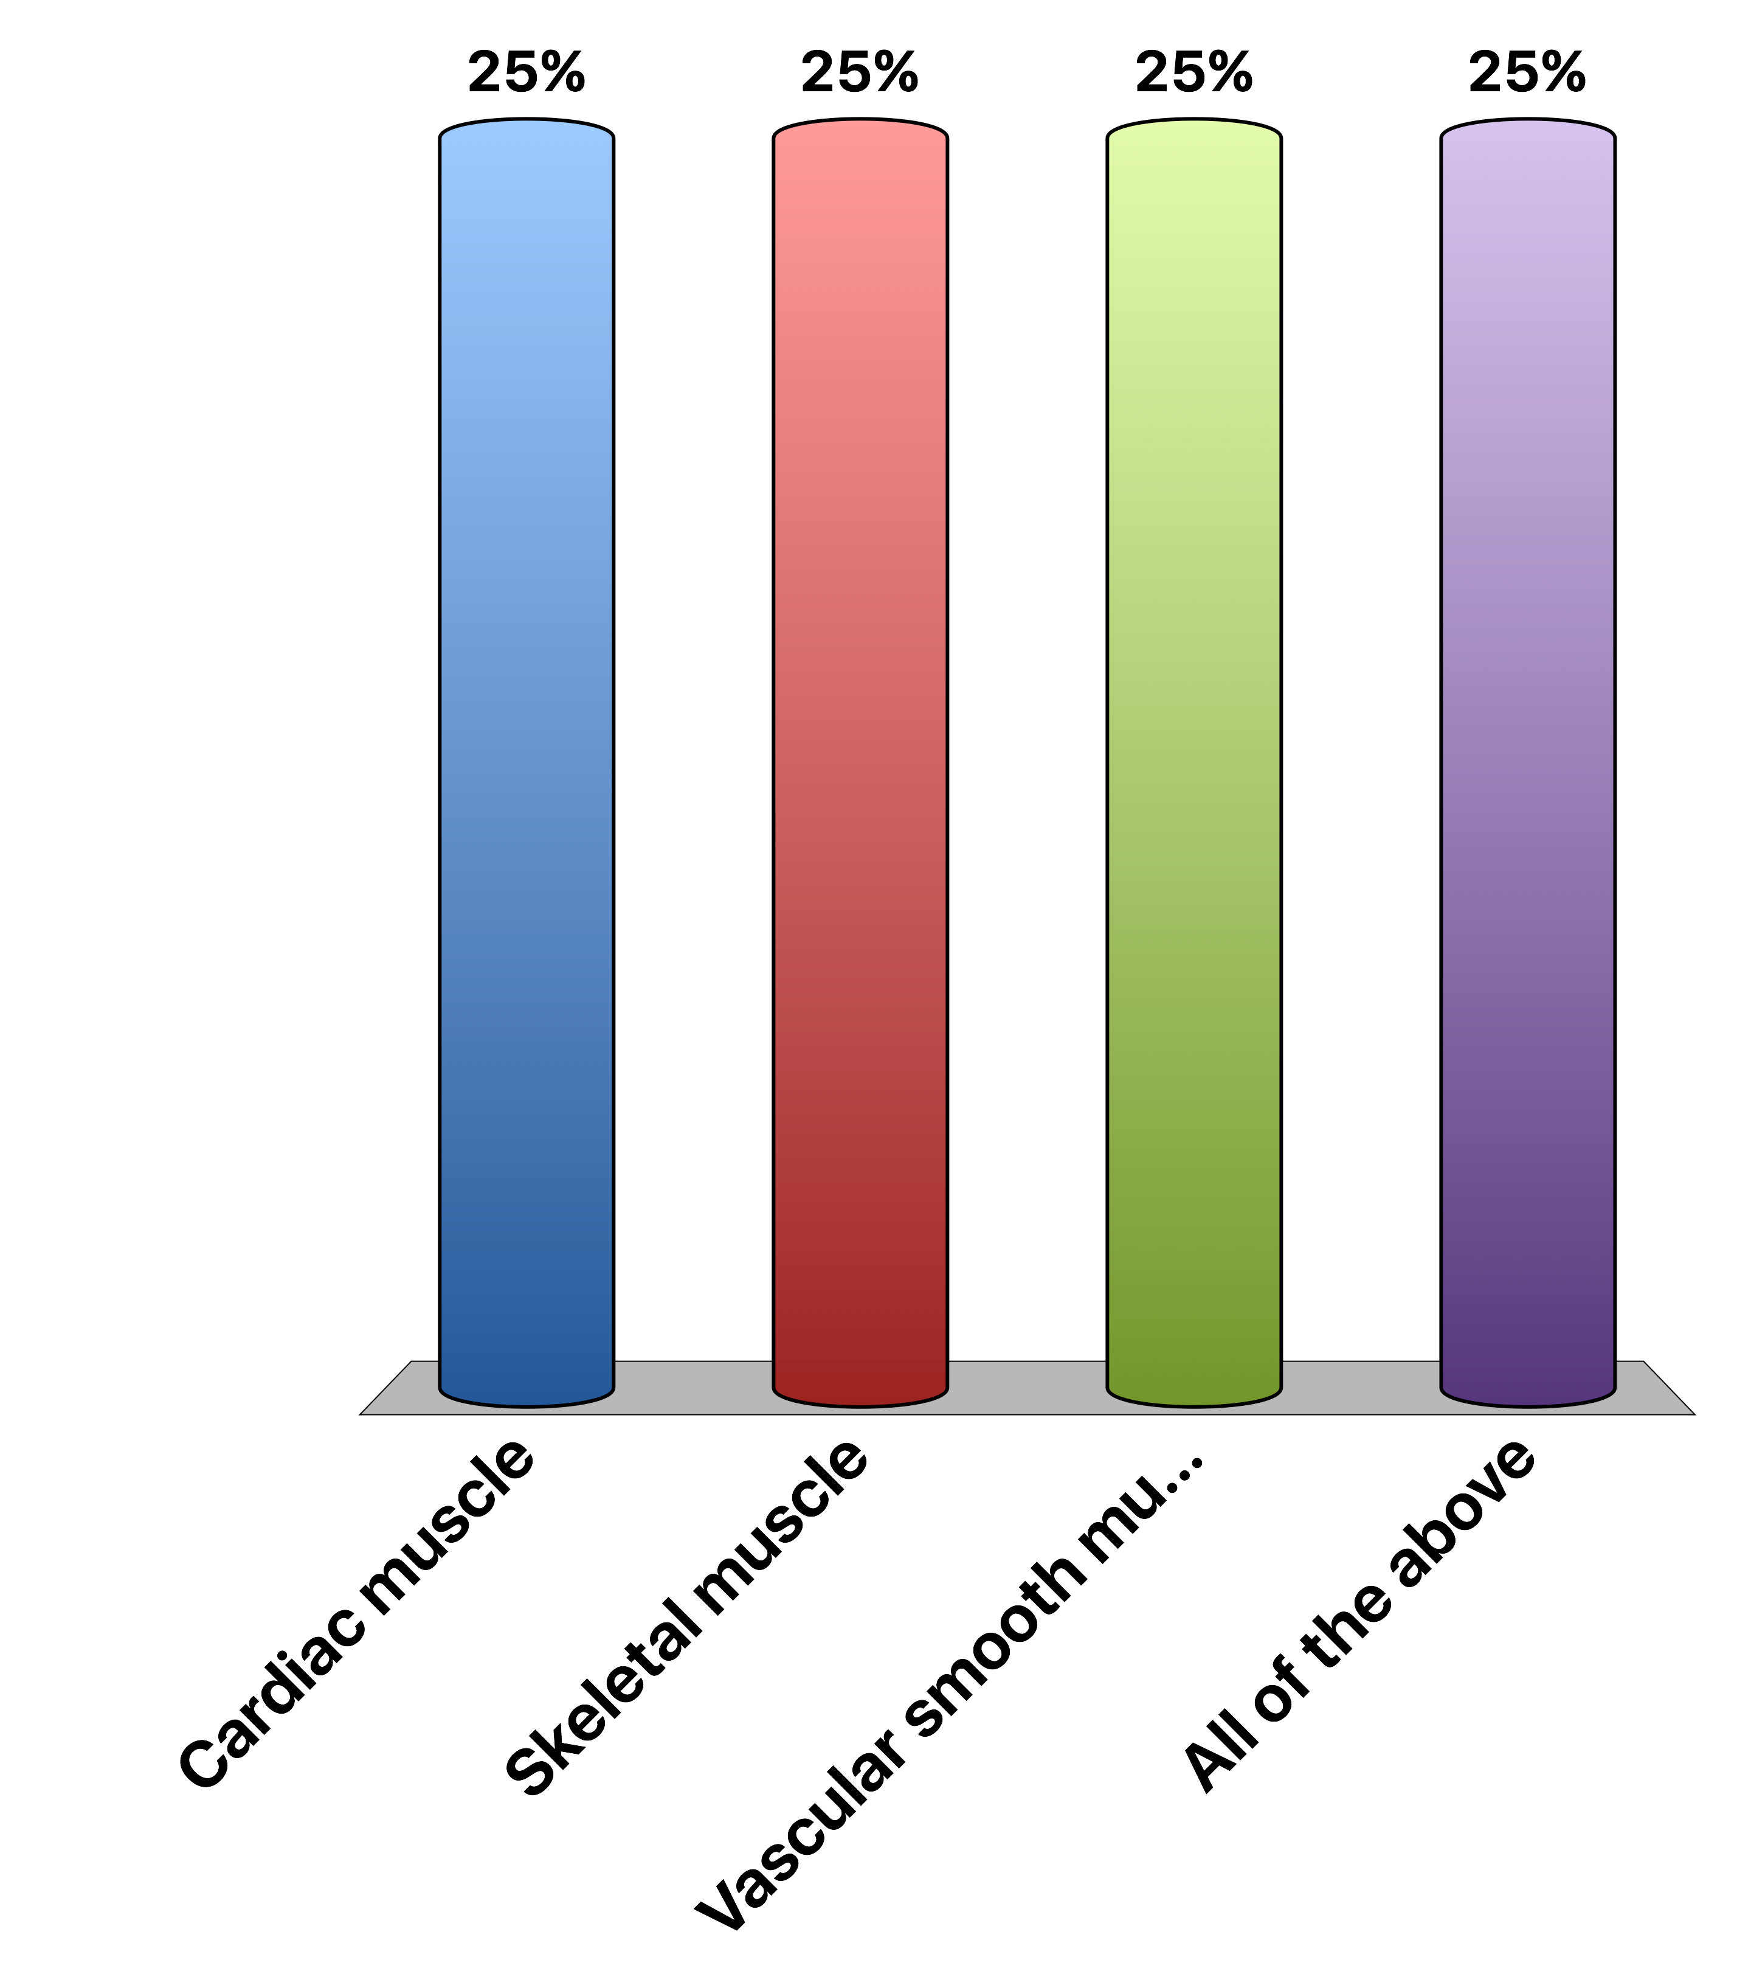
What cells respond to that signal
Cardiac muscle
Skeletal muscle
Vascular smooth muscle
All of the above
Response Counter
15

Slide 26
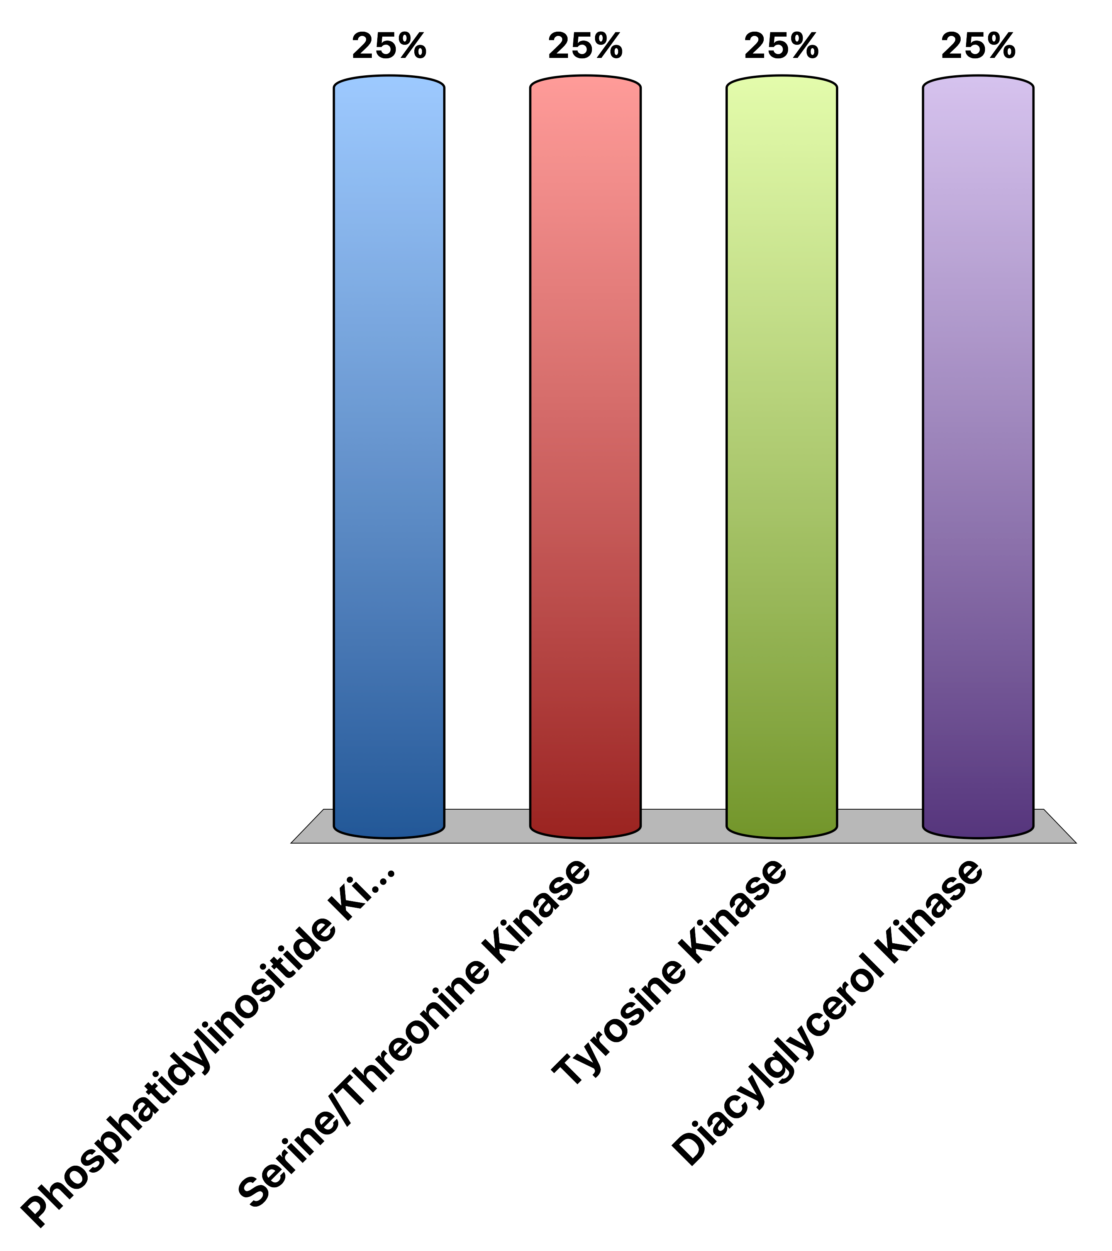
The Insulin Receptor is a…
Phosphatidylinositide Kinase
Serine/Threonine Kinase
Tyrosine Kinase
Diacylglycerol Kinase
Response Counter
15

Slide 27

Which process does cortisol accelerate
Glucose uptake in muscle
Gluconeogenesis
Protein synthesis
All of the above
Response Counter
15

Slide 28
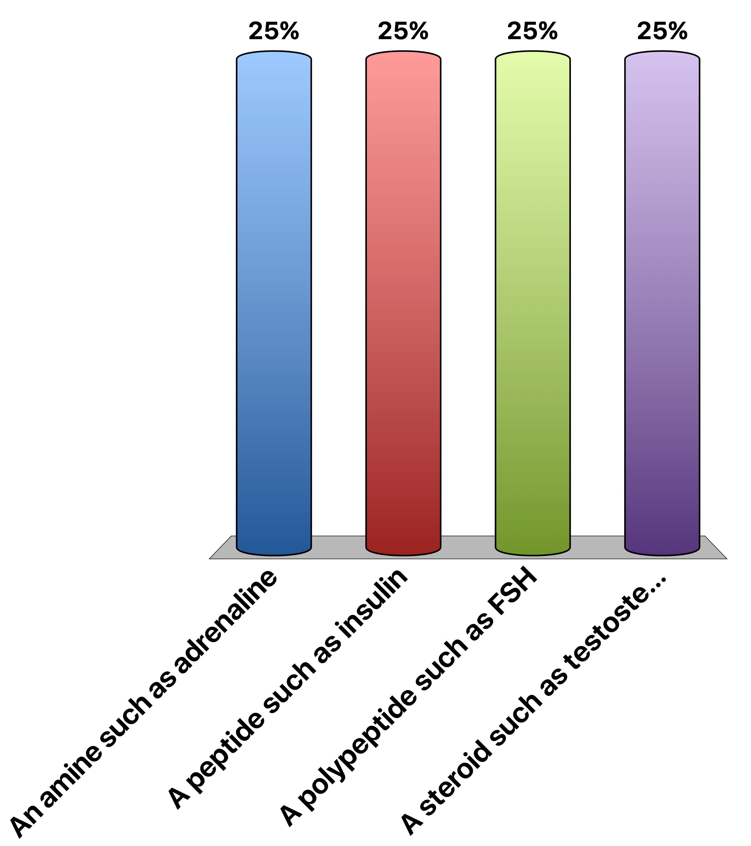
Which hormone type is most likely to be able to cross plasma membranes
An amine such as adrenaline
A peptide such as insulin
A polypeptide such as FSH
A steroid such as testosterone
Response Counter
15

Slide 29
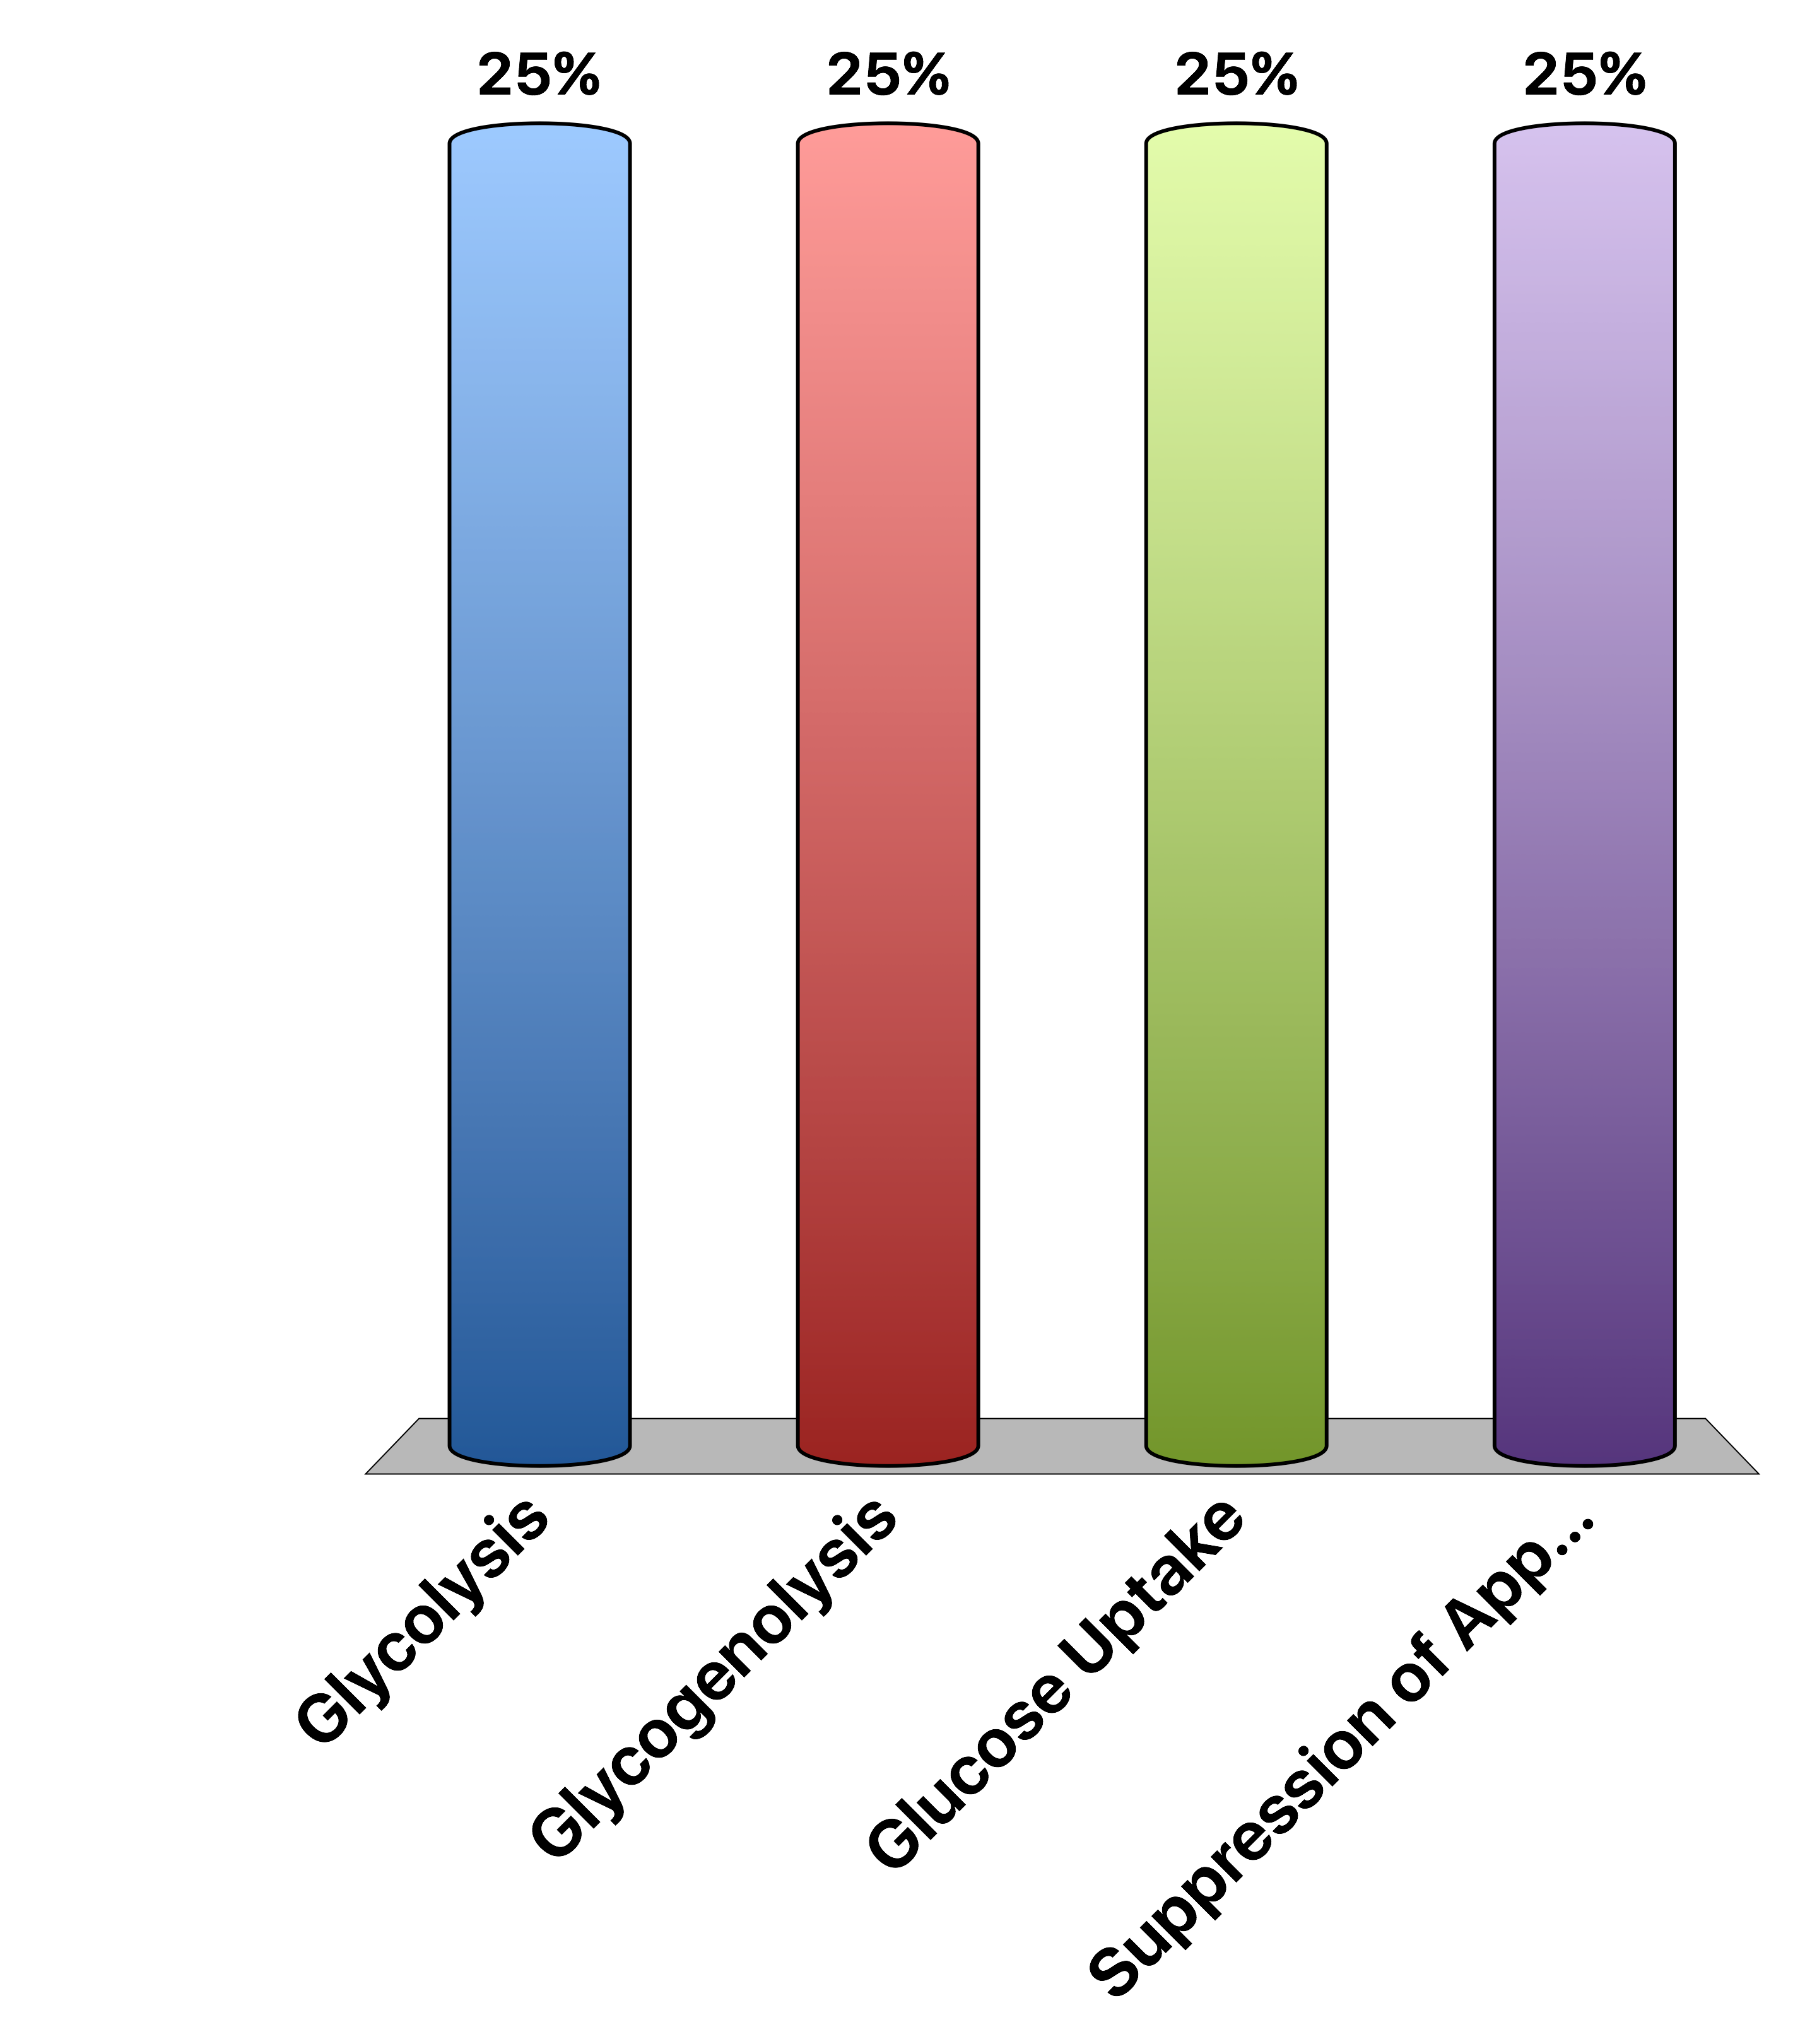
Which of the following will increase plasma glucose
Glycolysis
Glycogenolysis
Glucose Uptake
Suppression of Appetite
Response Counter
15

Slide 30
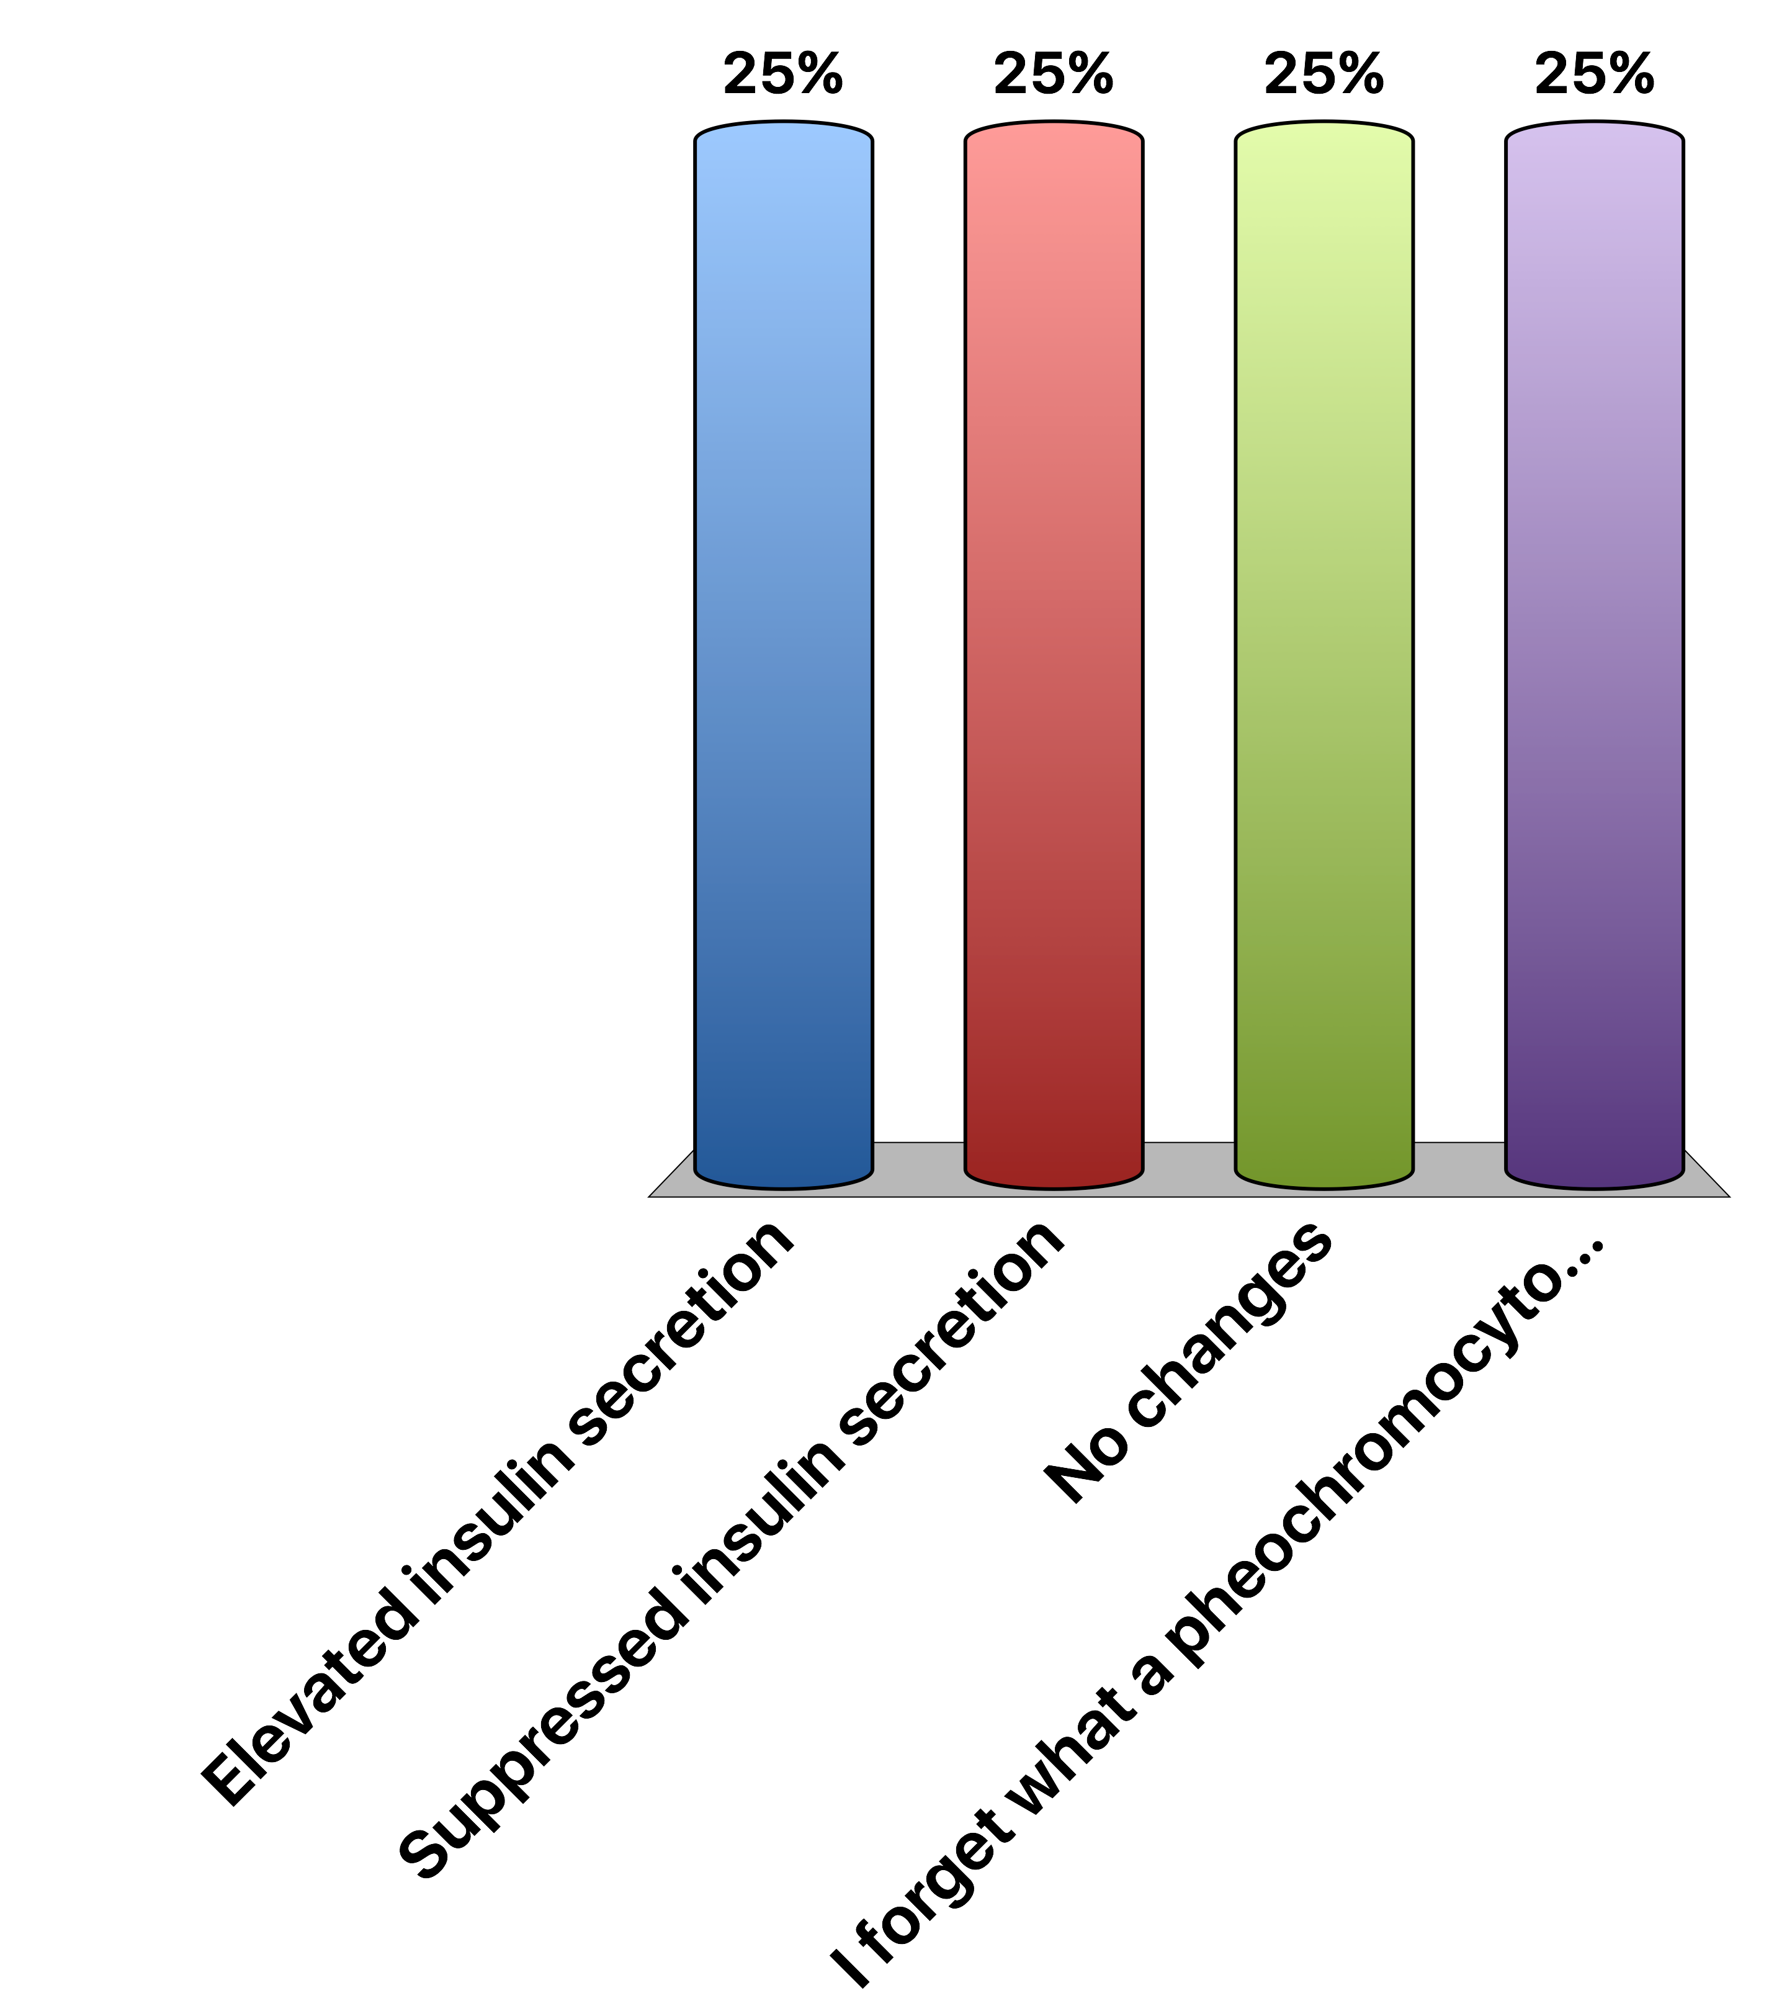
A patient with a pheochromocytoma should have
Elevated insulin secretion
Suppressed insulin secretion
No changes
I forget what a pheochromocytoma is
Response Counter
15
Notes:
Answer is B

Slide 31
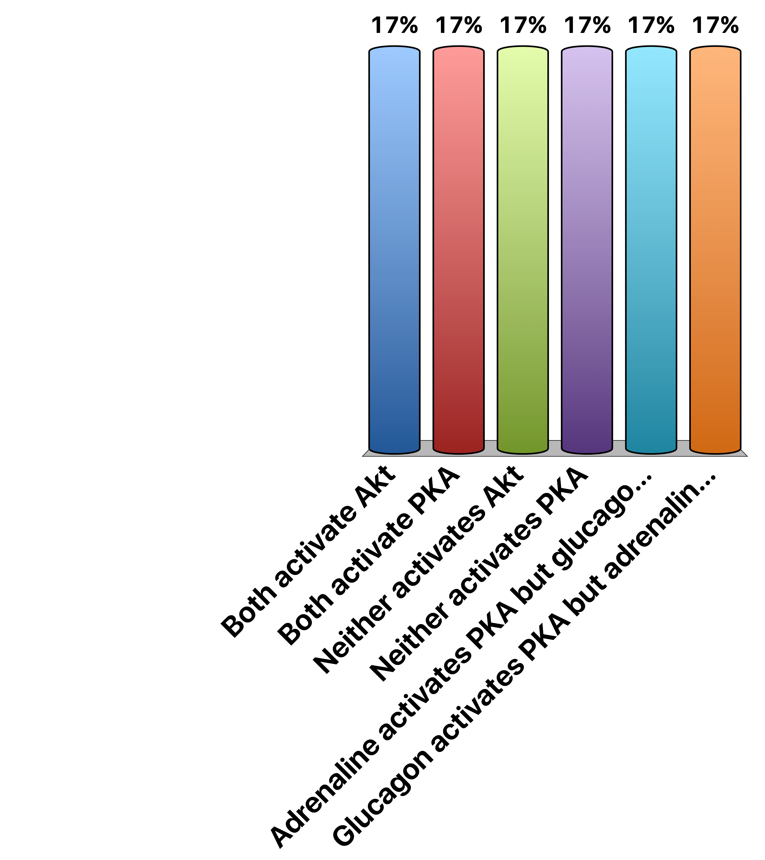
Adrenaline and Glucagon…
Both activate Akt
Both activate PKA
Neither activates Akt
Neither activates PKA
Adrenaline activates PKA but glucagon activates Akt
Glucagon activates PKA but adrenaline activates Akt
Response Counter
15
Notes:
Correct answer is B
Means that epinephrine and glucagon effects are identical in pancreas and liver

Slide 32

Somatostatin is a Gi-linked GPCR, so
Somatostatin activates PKA
Somatostatin decreases cAMP
Somatostatin receptor is a nuclear hormone receptor
All of the above
Response Counter
15

Slide 33
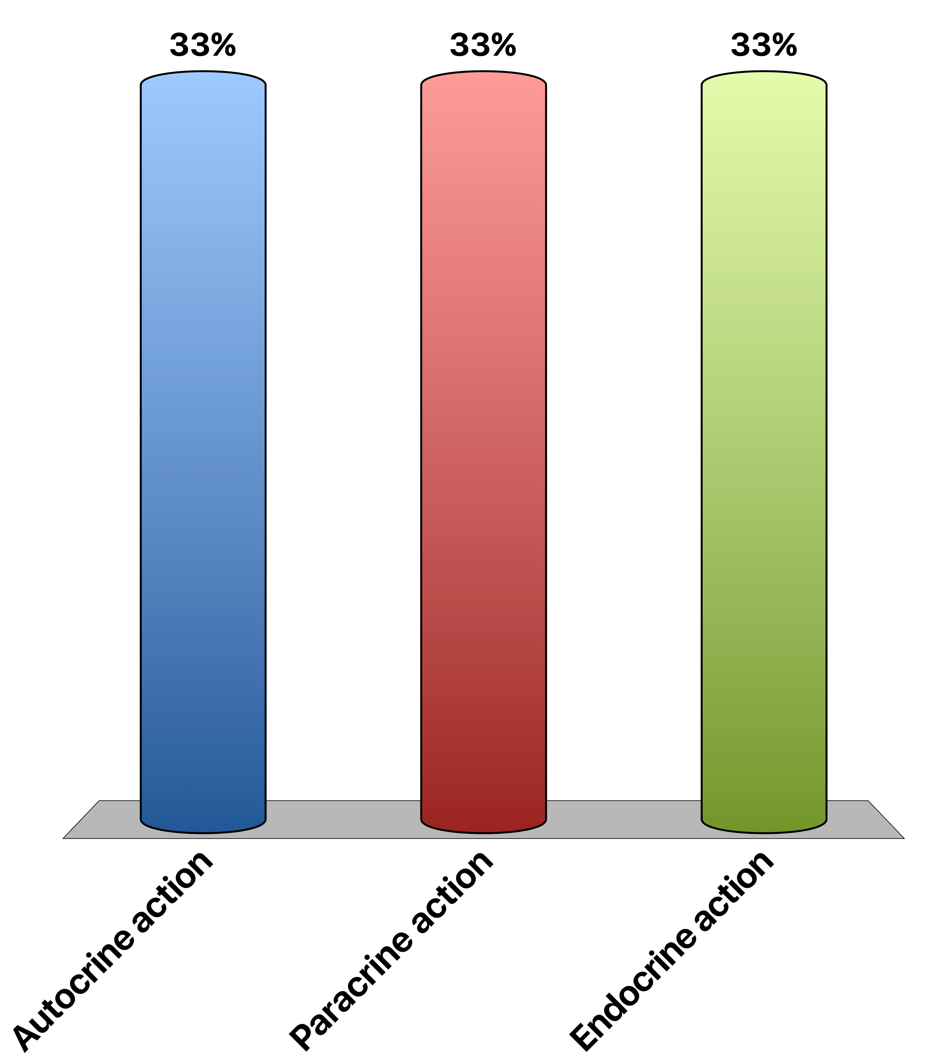
Insulin is released from pancreatic beta cells and is sensed by pancreatic alpha cells to reduce glucagon secretion. This is an example of …
Autocrine action
Paracrine action
Endocrine action
Response Counter
15

Slide 34
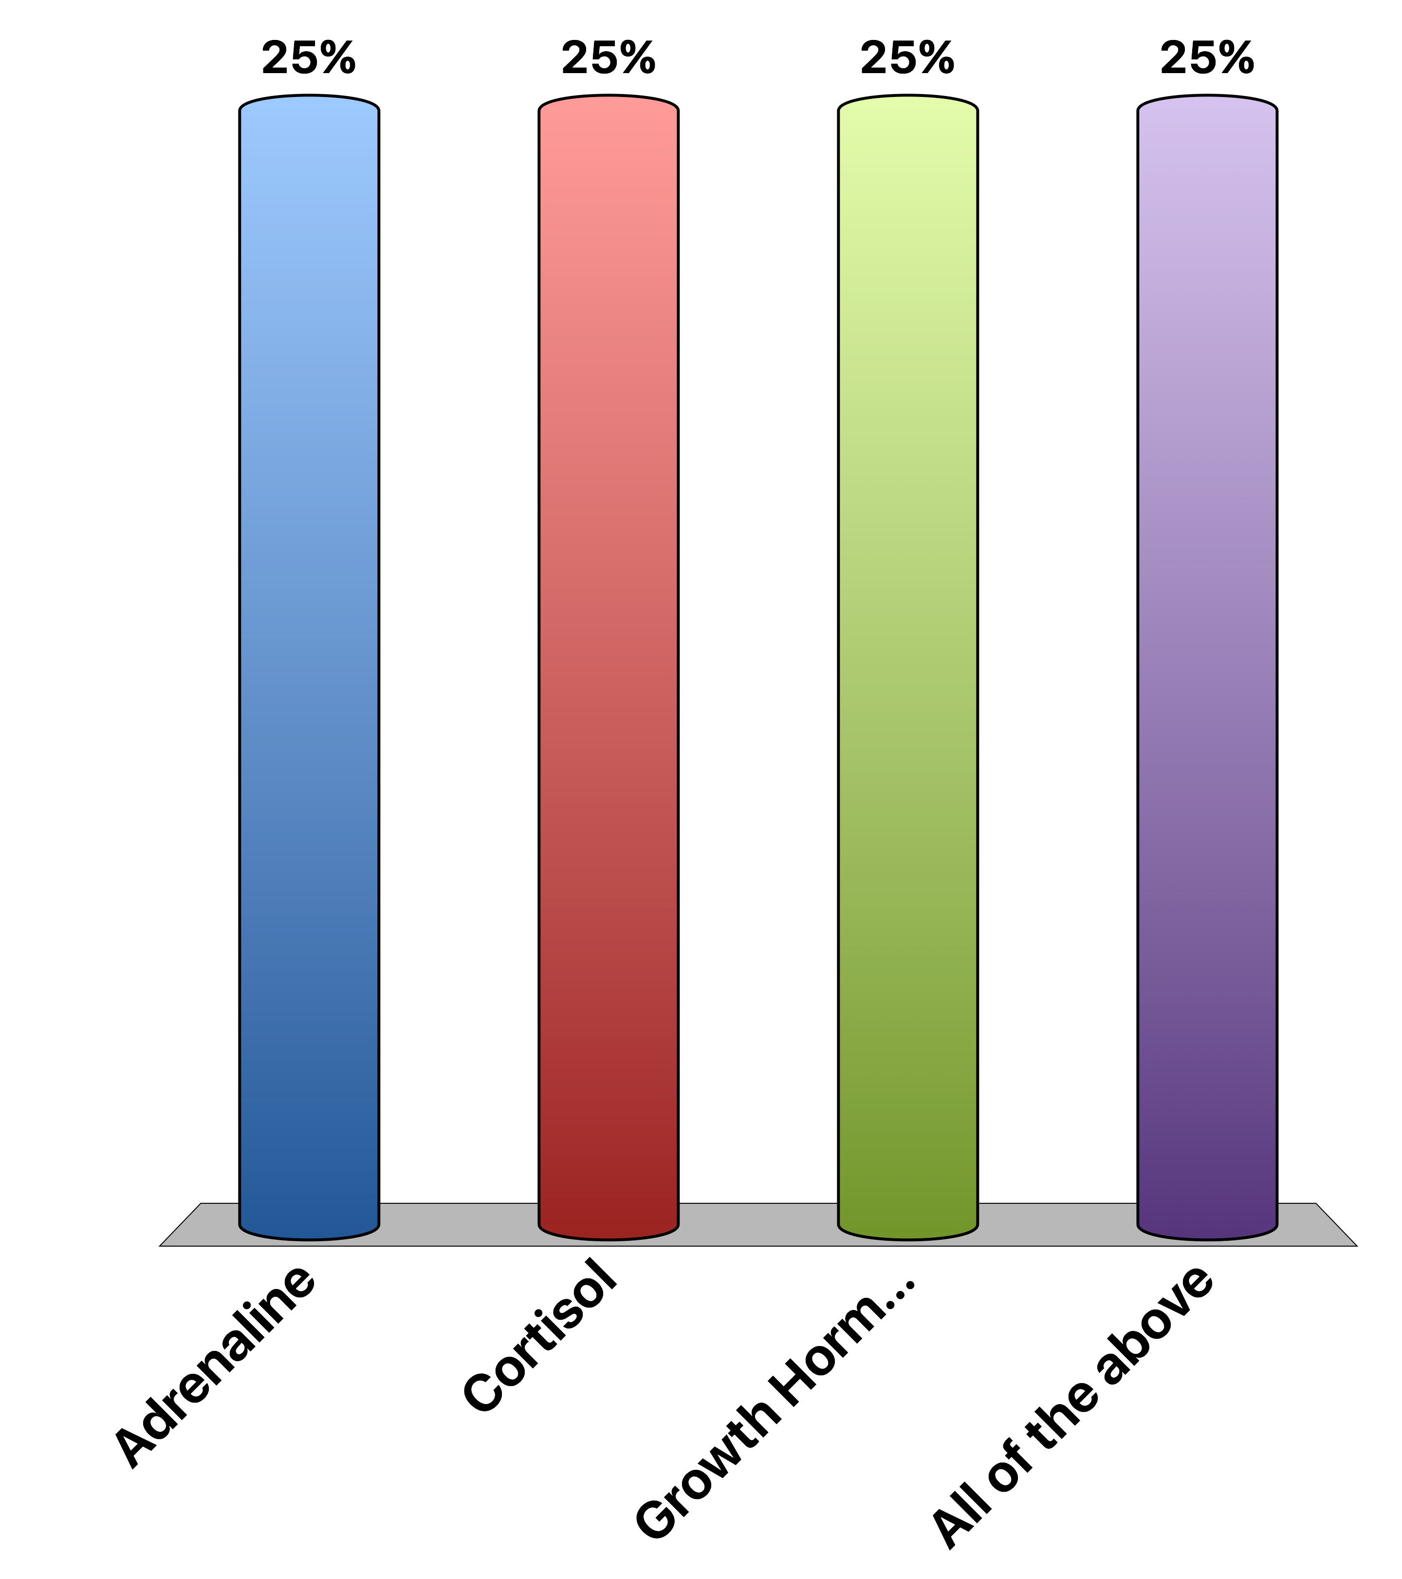
Which hormone is unlikely to be BBB-permeable without transport
Adrenaline
Cortisol
Growth Hormone
All of the above
Response Counter
15

Slide 35
The posterior pituitary is connected to the hypothalamus by direct neuronal contacts
True
False
Response Counter
15

Slide 36
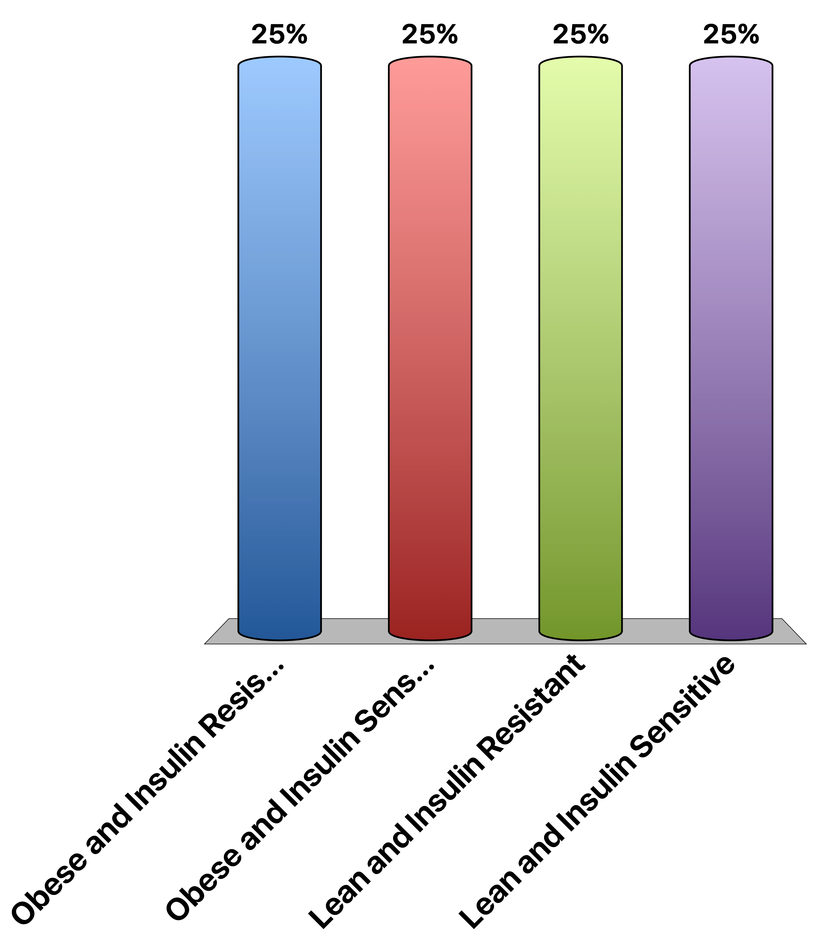
Type II Diabetics Tend To Be…
Obese and Insulin Resistant
Obese and Insulin Sensitive
Lean and Insulin Resistant
Lean and Insulin Sensitive
Response Counter
15
Notes:
Correct answer is A

Slide 37

The hypothalamus wants to tell the anterior pituitary to secrete ACTH. How would this be done
Hypothalamic neurons have synaptic contacts with ACTH releasing cells
Hypothalamic neurons release a ACTH-releasing hormone
Neither A nor B
Both A + B
Response Counter
15

Slide 38
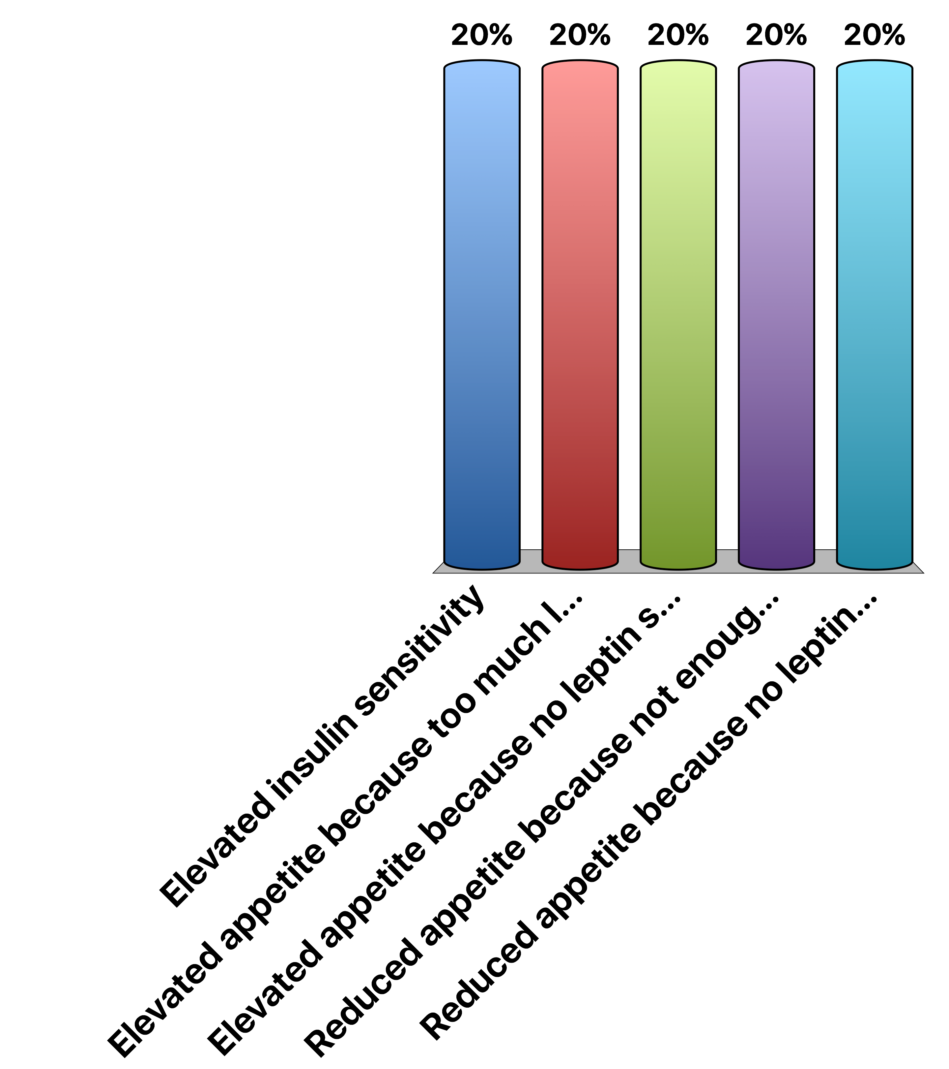
Why would Leptin or Leptin Receptor mutant subjects become obese
Elevated insulin sensitivity
Elevated appetite because too much leptin signaling
Elevated appetite because no leptin signaling
Reduced appetite because not enough leptin signaling
Reduced appetite because no leptin signaling
Response Counter
15
Notes:
Correct answer is C

Slide 39

How Is Specificity Achieved in Hypothalamlic-Anterior Pituitary Signaling
Specialized target cells
Specific and direct neuronal connections
Different signaling cascades
All of the above
Response Counter
15

Slide 40
How Is Specificity Achieved in Hypothalamlic-Anterior Pituitary Signaling
Specialized target cells
Specific and direct neuronal connections
Different signaling cascades
All of the above
Response Counter
15

Slide 41

The carotid sinus senses increased blood volume due to drinking too much water…
Vasopressin is released
Vasopressin release is inhibited
The carotid sinus cant sense blood volume
More water is retained
Response Counter
15

Slide 42
If vasopressin release is activated by ethanol, this would cause increased urination
True
False
Response Counter
15
Notes:
False because more vasopressin would mean more water retention

Slide 43

Which of the following is a peptide hormone
Growth Hormone
Vasopressin
Testosterone
Epinephrine
Response Counter
15

Slide 44
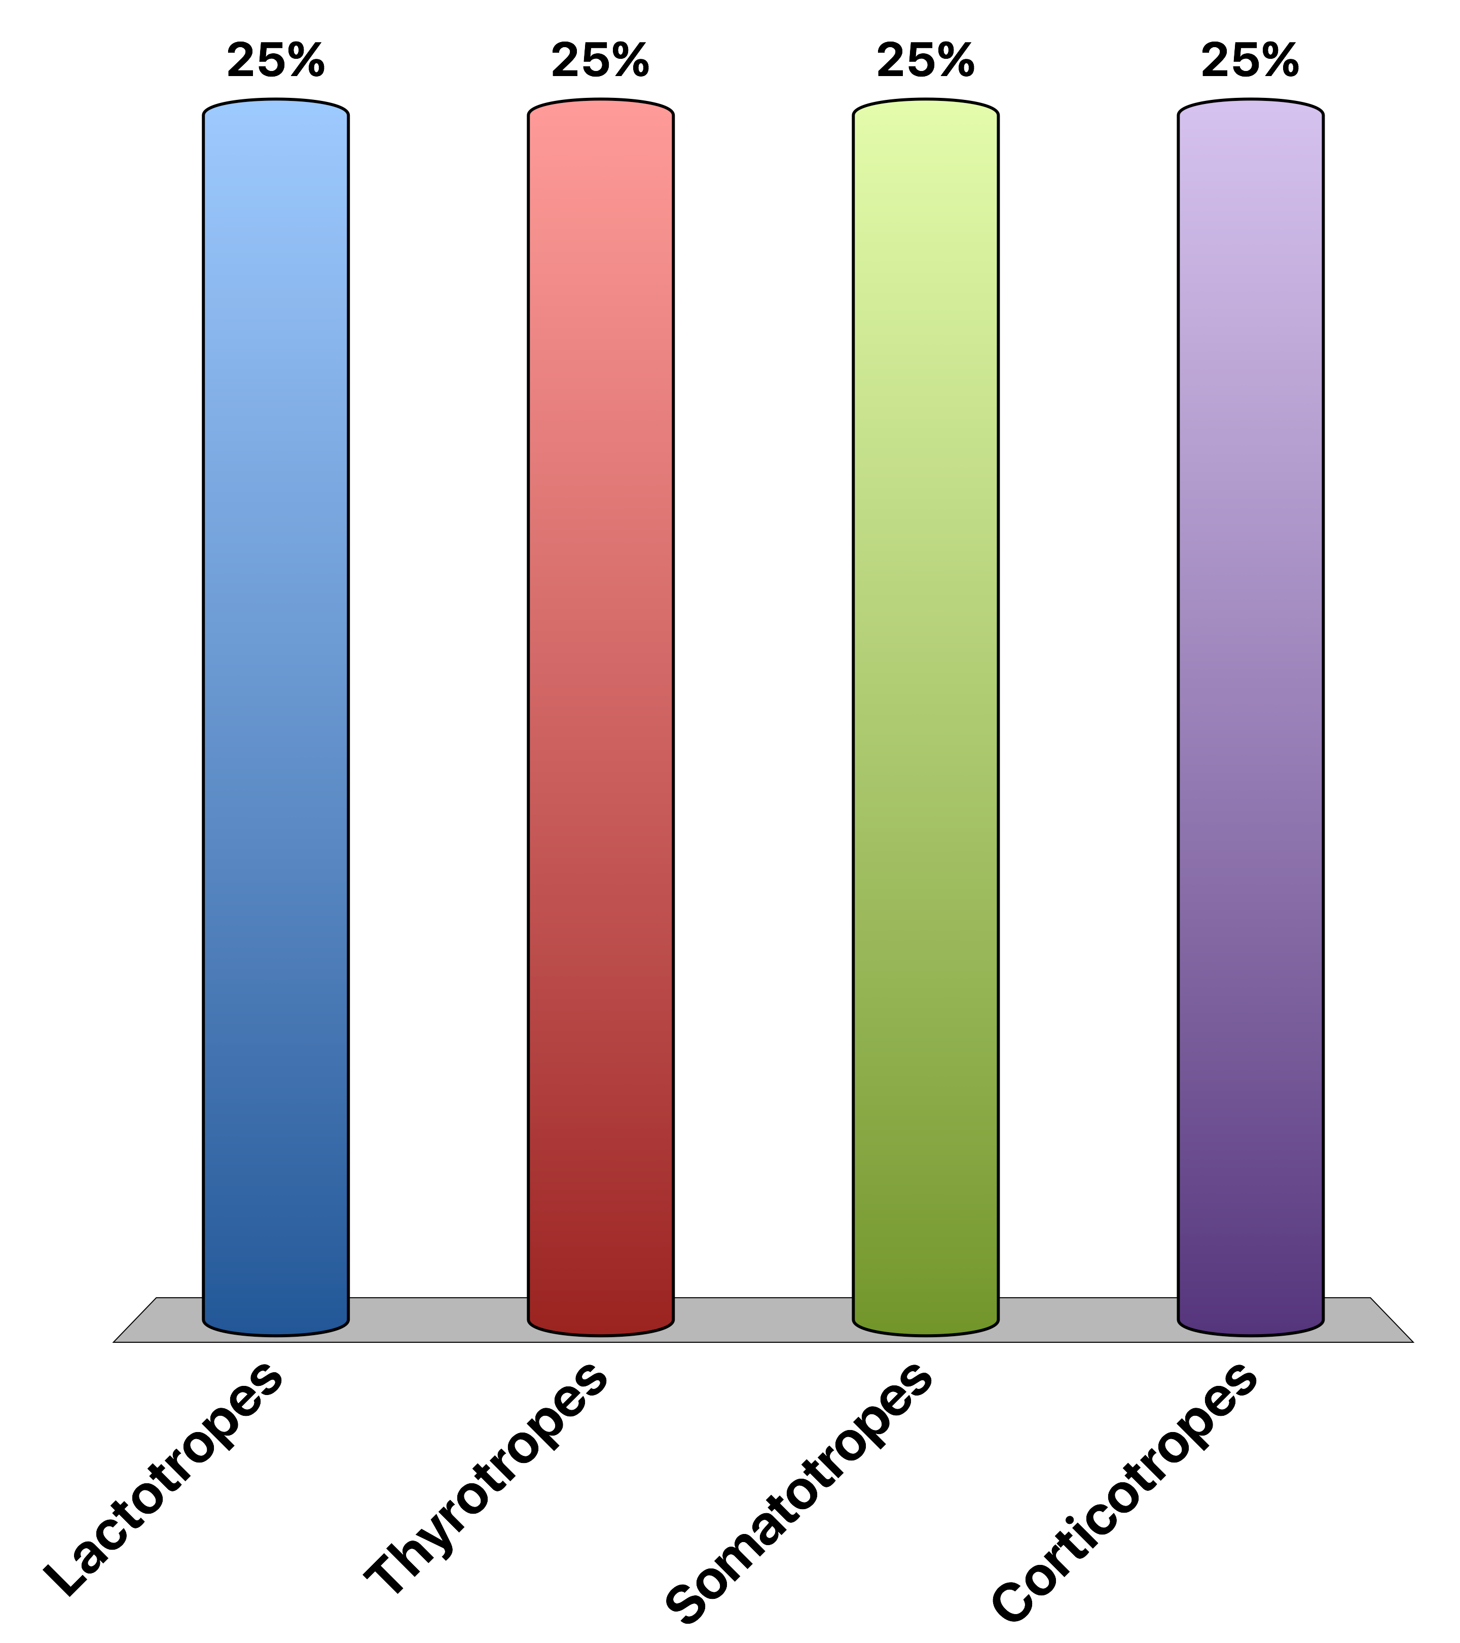
What Cell Type Secretes Growth Hormone
Lactotropes
Thyrotropes
Somatotropes
Corticotropes
Response Counter
15

Slide 45

Drinking a lot of water will…
Increase vasopressin levels, causing water reuptake
Increase vasopressin levels, causing water excretion
Decrease vasopressin levels, causing water reuptake
Decrease vasopressin levels, causing water excretion
Response Counter
15

Slide 46

Direct Aldosterone Effects on Cells Are…
Mediated by a GPCR
Rapid because of the post-translational modification of enzymes
Dependent on new mRNA synthesis
All of the above
Response Counter
15

Slide 47
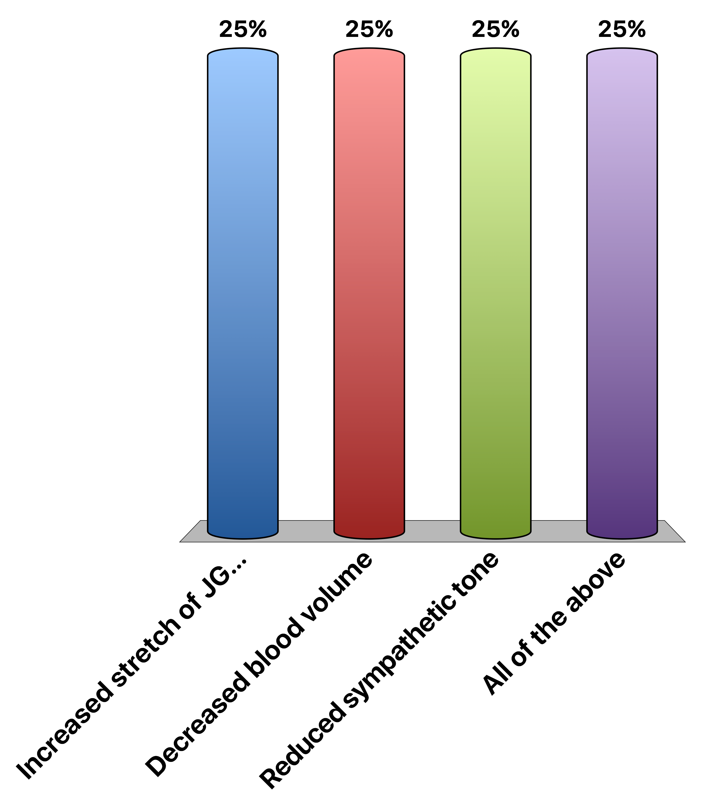
Renin Secretion is Stopped By
Increased stretch of JG cells
Decreased blood volume
Reduced sympathetic tone
All of the above
Response Counter
15

Slide 48

Which hormone should mediate chronic stress responses?
Epinephrine because it functions quickly
Epinephrine because its effects last longer
Cortisol because it functions quickly
Cortisol because its effects last longer
Response Counter
15

